Slide 1
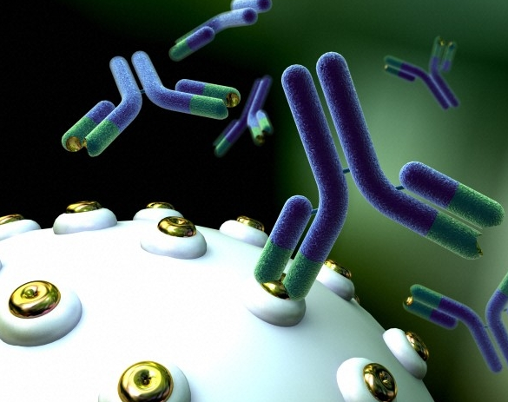
Targeted Treatment for Colorectal Cancer Through Monoclonal Antibodies
Harnessing the Immune System:​
Omar Flores

Slide 2
Overview
Background
Synthesizing Insert Sequences
Process / Results
Conclusions / Future Work
Application
Panitumumab
General Information

Slide 3

Background Information

Slide 4

Colonization of Mars
Elon Musk plans to land humans on Mars by 2026.
Health Issues to Overcome:
  Space sickness
  Mental Stress
  Weaker muscles
  Eye problems
  Medical Emergencies
8-month journey to Earth

Slide 5

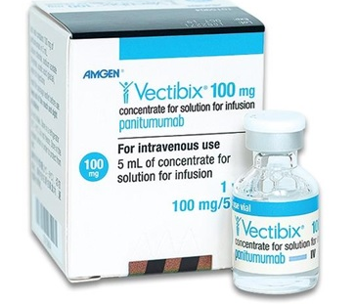
Colorectal Cancer
40% of astronauts have had polyps removed.
Panitumumab
  FDA approved
  Treats cancer that has metastasized.
Produced by Amgen and Illumina in 2014.
Trade Name: Vectibix

Slide 6
Monoclonal Antibody Immunotherapy
Immunotherapy: Medical treatment of diseases by activating or suppressing the immune system.
Antibody: Protein produced by the immune system in response to a foreign substance.
Monoclonal Antibody (mAb): Designed to mimic the immune system's ability to target specific cells.
Potential application in cancer treatment, autoimmune disorders, infectious diseases, and organ transplantation.

Slide 7
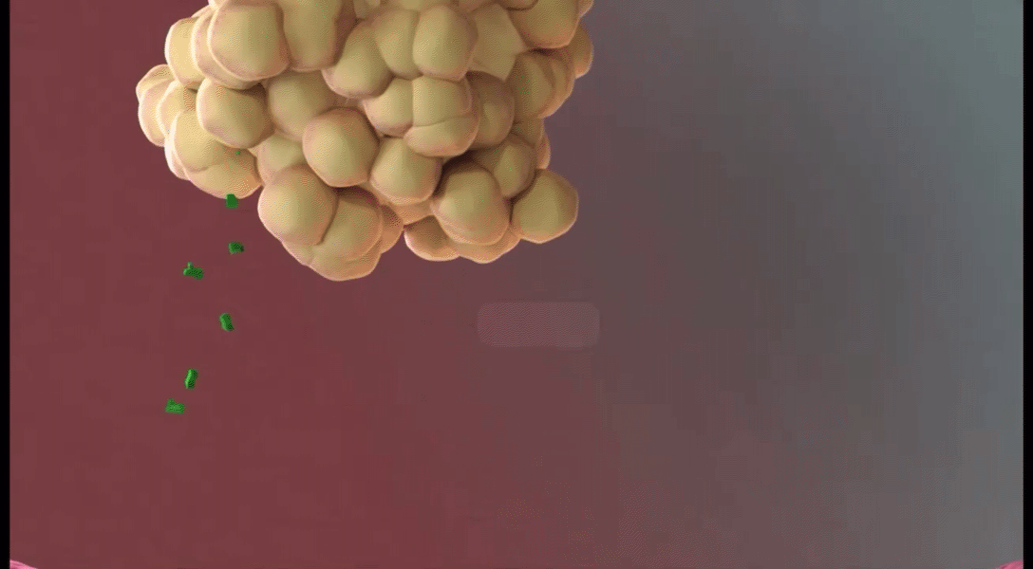
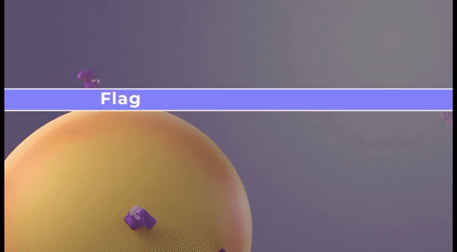
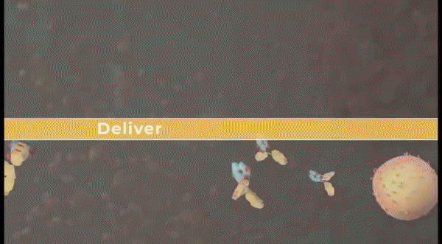
Monoclonal Antibodies: Effector Functions
1.) Block molecules that cancer cells need to grow.
2.) Flag cancer cells for destruction by the body's immune system.
3.) Deliver harmful substances to cancer cells.
Neutralization
Opsonization
Complement

Slide 8
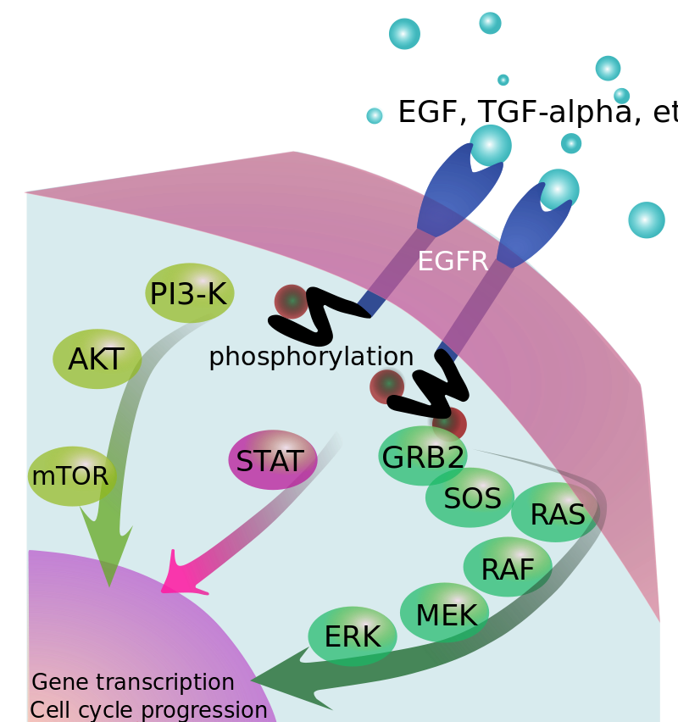
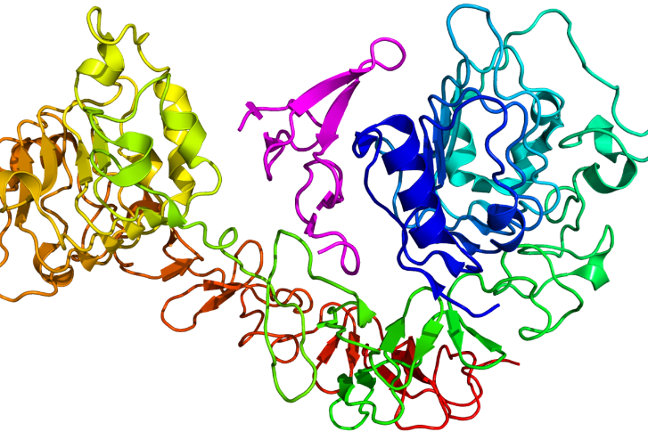
Panitumumab: Neutralization
Epidermal Growth Factor Receptor (EGFR)
  Protein found on cells that play a vital role in promoting cell growth.
Blocks EGFR
  Stops downstream signaling (MAPK).
  Prevents cellular proliferation, survival, and migration.

Slide 9
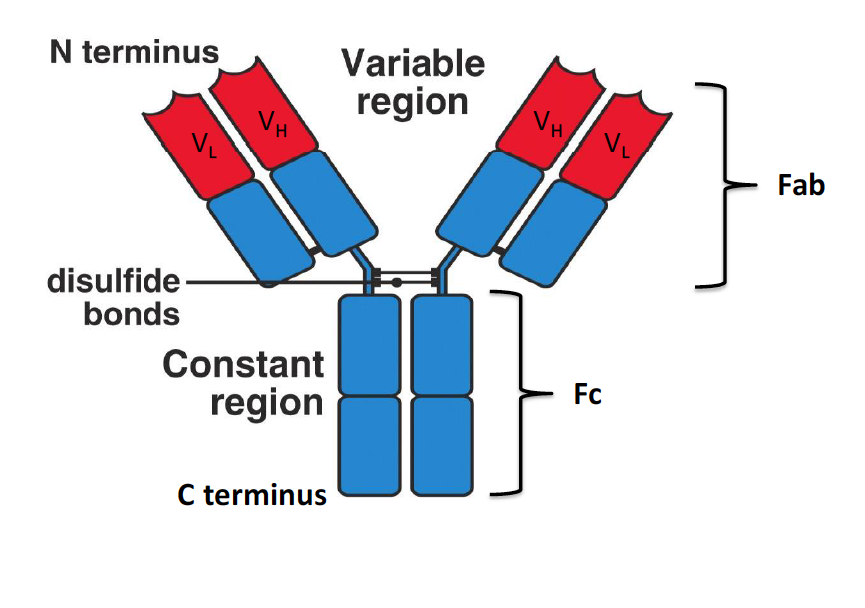
Antibody Structure: Constant Region
Remains the same across different antibody molecules (Fc Fragment).
Provides structural stability.
Plays a role in determining effector functions.
C_{H}
C_{H}
C_{L}
C_{L}
C_{H}
C_{H}
C_{H}
C_{H}

Slide 10
Antibody Structure: Variable Region
Responsible for recognizing and binding to antigens. (Fab Fragment)
Highly specific and unique to each antibody.
C_{H}
C_{H}
C_{L}
C_{L}
C_{H}
C_{H}
C_{H}
C_{H}

Slide 11

Synthesizing Insert Sequences

Slide 12

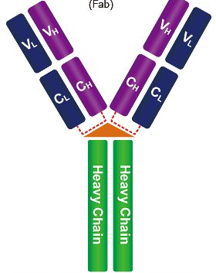
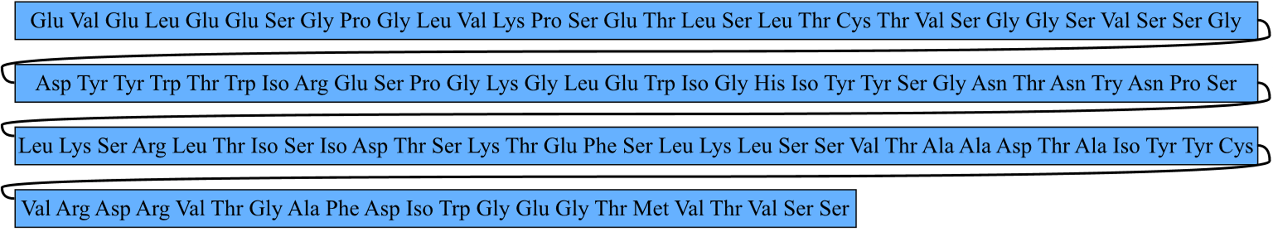
Amino Acid: Heavy Chain
Amino Acid Information
  Number of Amino Acids: 119
  Size of Amino Acids: 228 kDa
Amino Acid Sequence

Slide 13
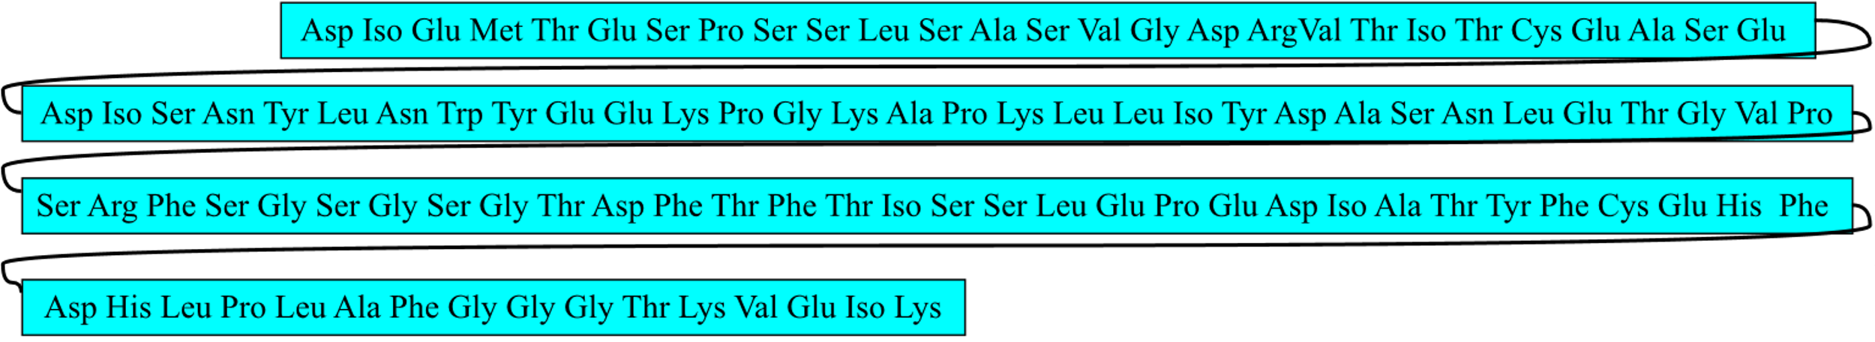
Amino Acid: Light Chain
Amino Acid Information
  Number of Amino Acids: 107
  Size of Amino Acids: 208 kDa
Amino Acid Sequence

Slide 14
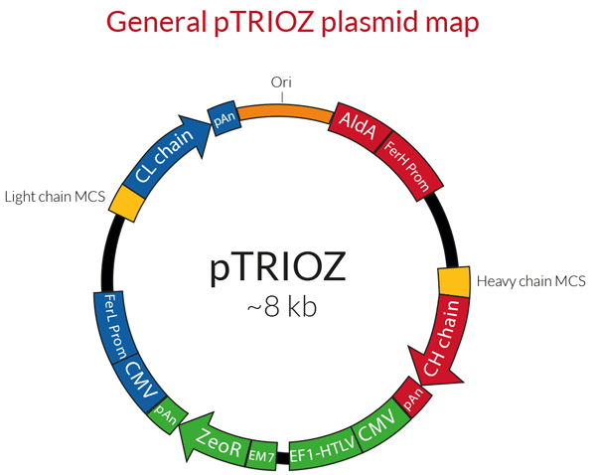
Plasmid Information
Plasmid Name: pTRIOZ-hIgG1
Description: Designed for high-yield production of whole monoclonal antibodies (mAbs) with the use of a single plasmid.
Three Cassettes:
Heavy Chain
Light Chain
Antibiotic Selection of Zeocin

Slide 15
Plasmid Information
Plasmid Name: pTRIOZ-hIgG1
Description: Designed for high-yield production of whole monoclonal antibodies (mAbs) with the use of a single plasmid.
Three Cassettes:
Heavy Chain
Light Chain
Antibiotic Selection of Zeocin

Slide 16
Plasmid Information
Plasmid Name: pTRIOZ-hIgG1
Description: Designed for high-yield production of whole monoclonal antibodies (mAbs) with the use of a single plasmid.
Three Cassettes:
Heavy Chain
Light Chain
Antibiotic Selection of Zeocin

Slide 17

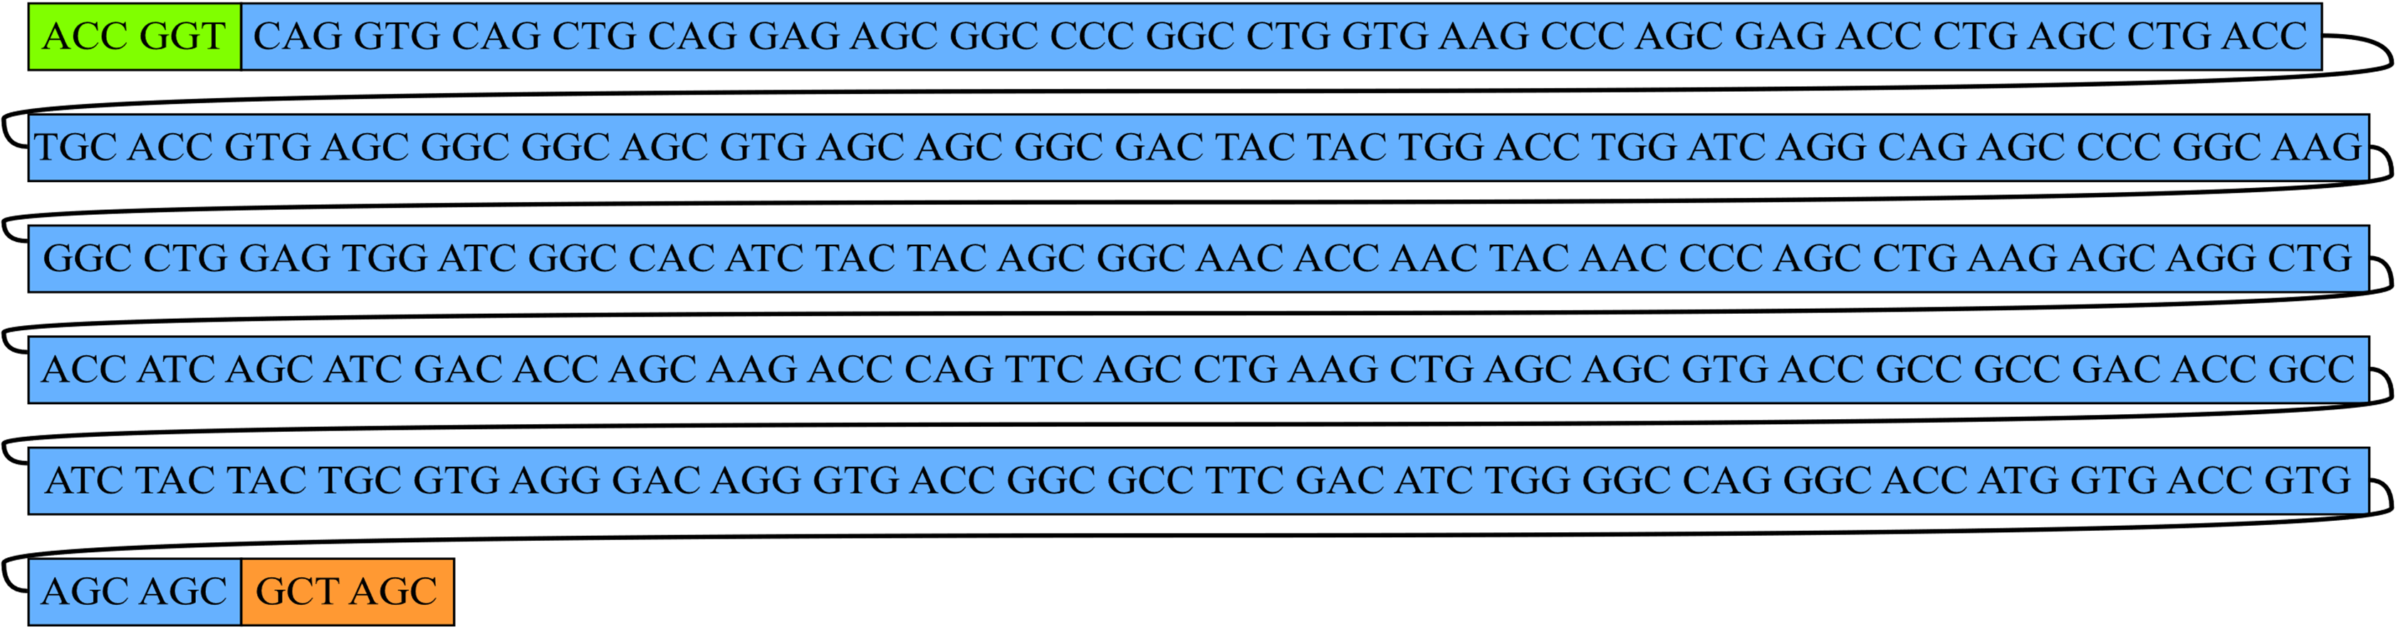
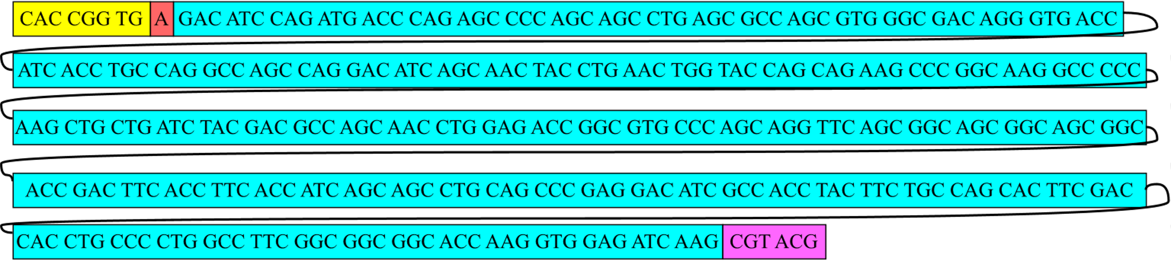
Restriction Sites
Restriction enzymes add amino acids to inserts.
Addition of adenine keeps amino acids in frame.
Heavy Chain
Thr Gly Ala Ser
Light Chain
His Arg Ter Arg Thr

Slide 18
Nucleic Acid: Heavy Chain

Slide 19
Nucleic Acid: Light Chain

Slide 20
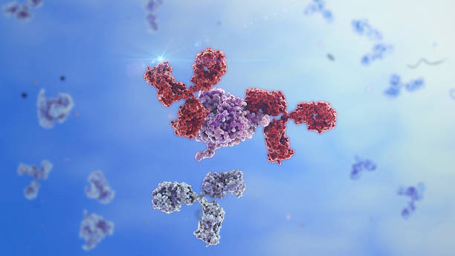
Process and Results

Slide 21
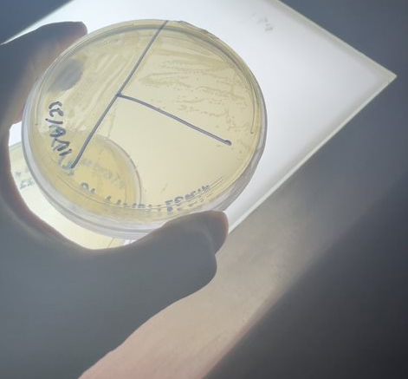
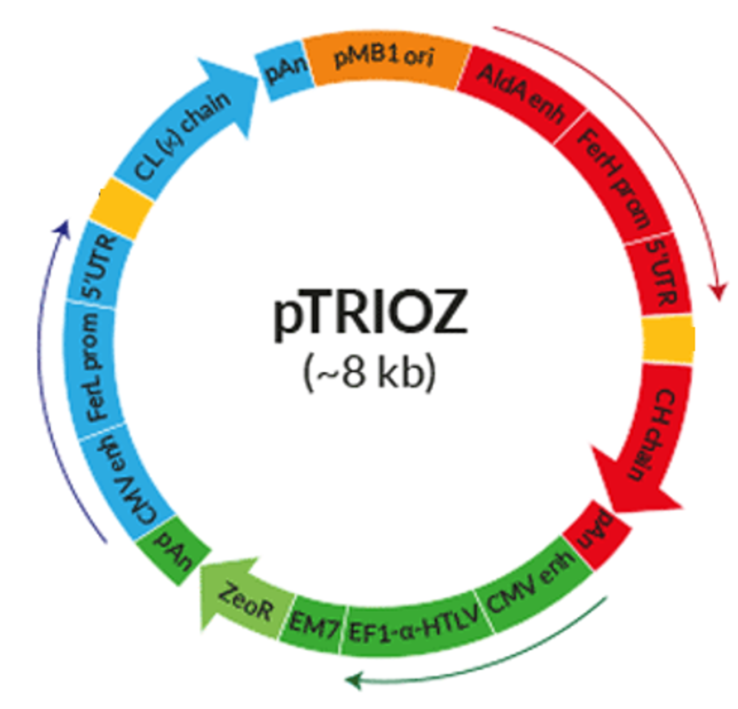
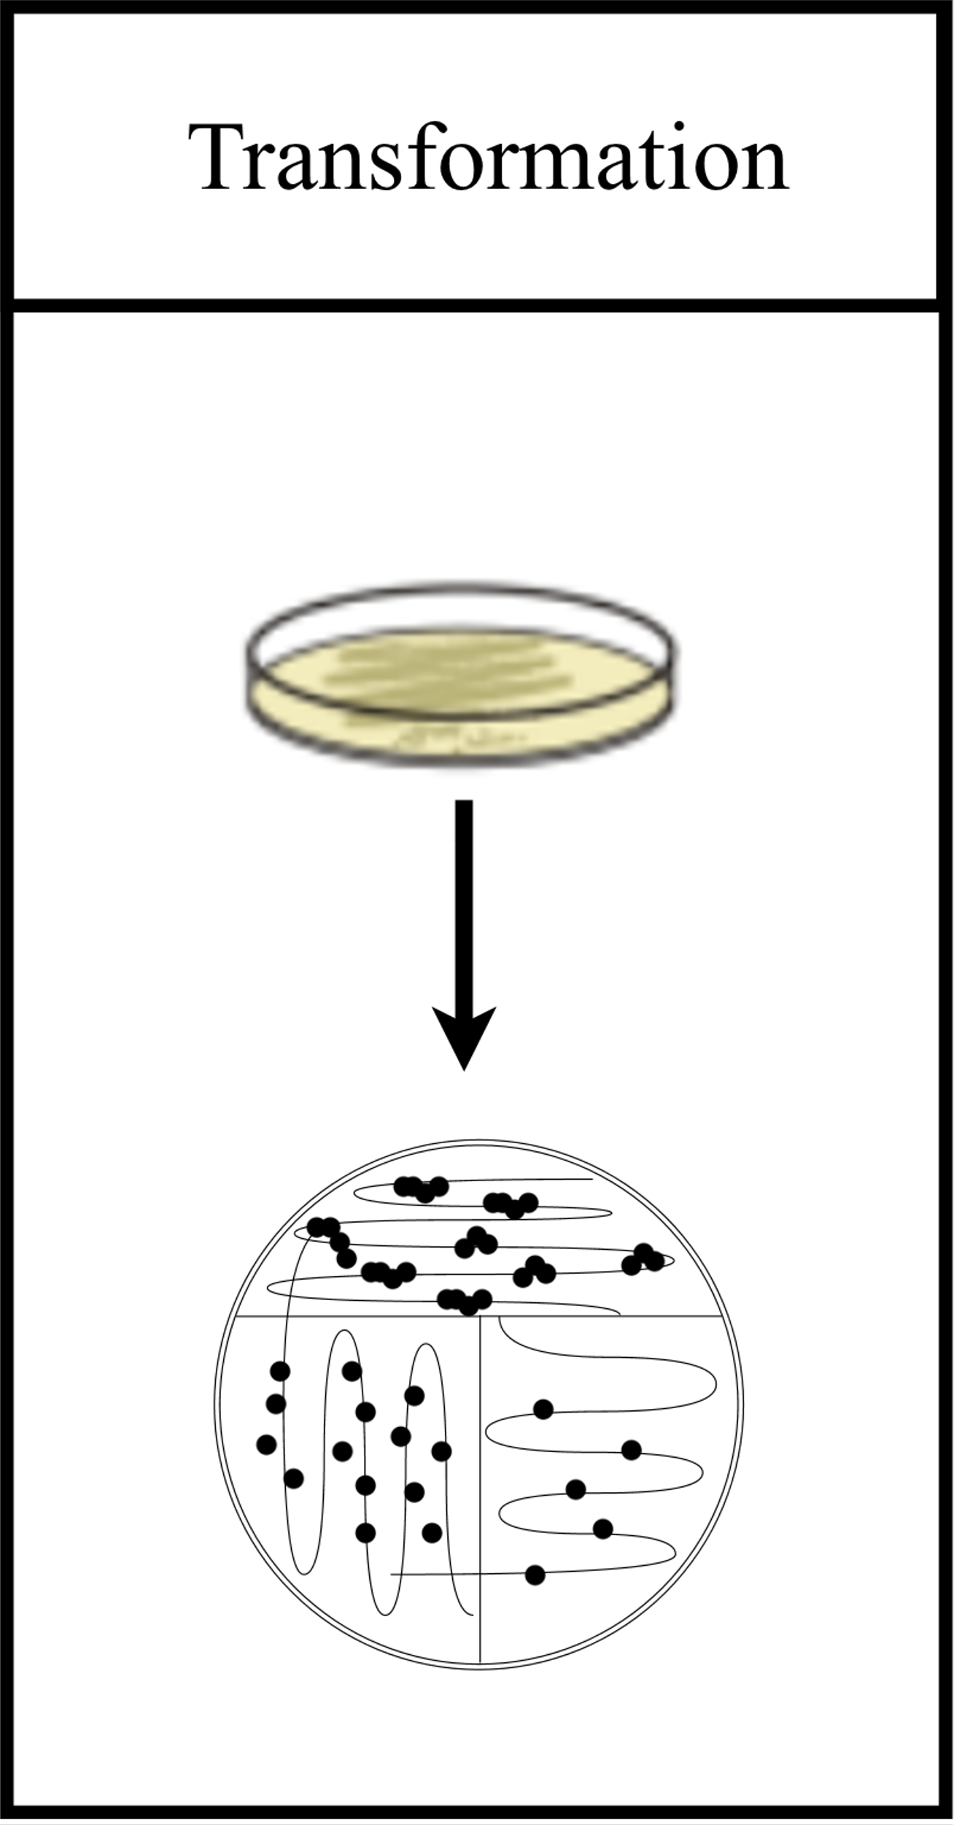
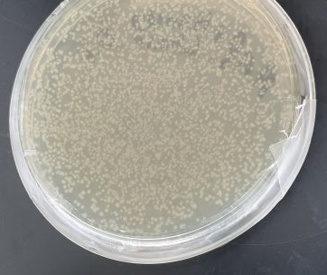
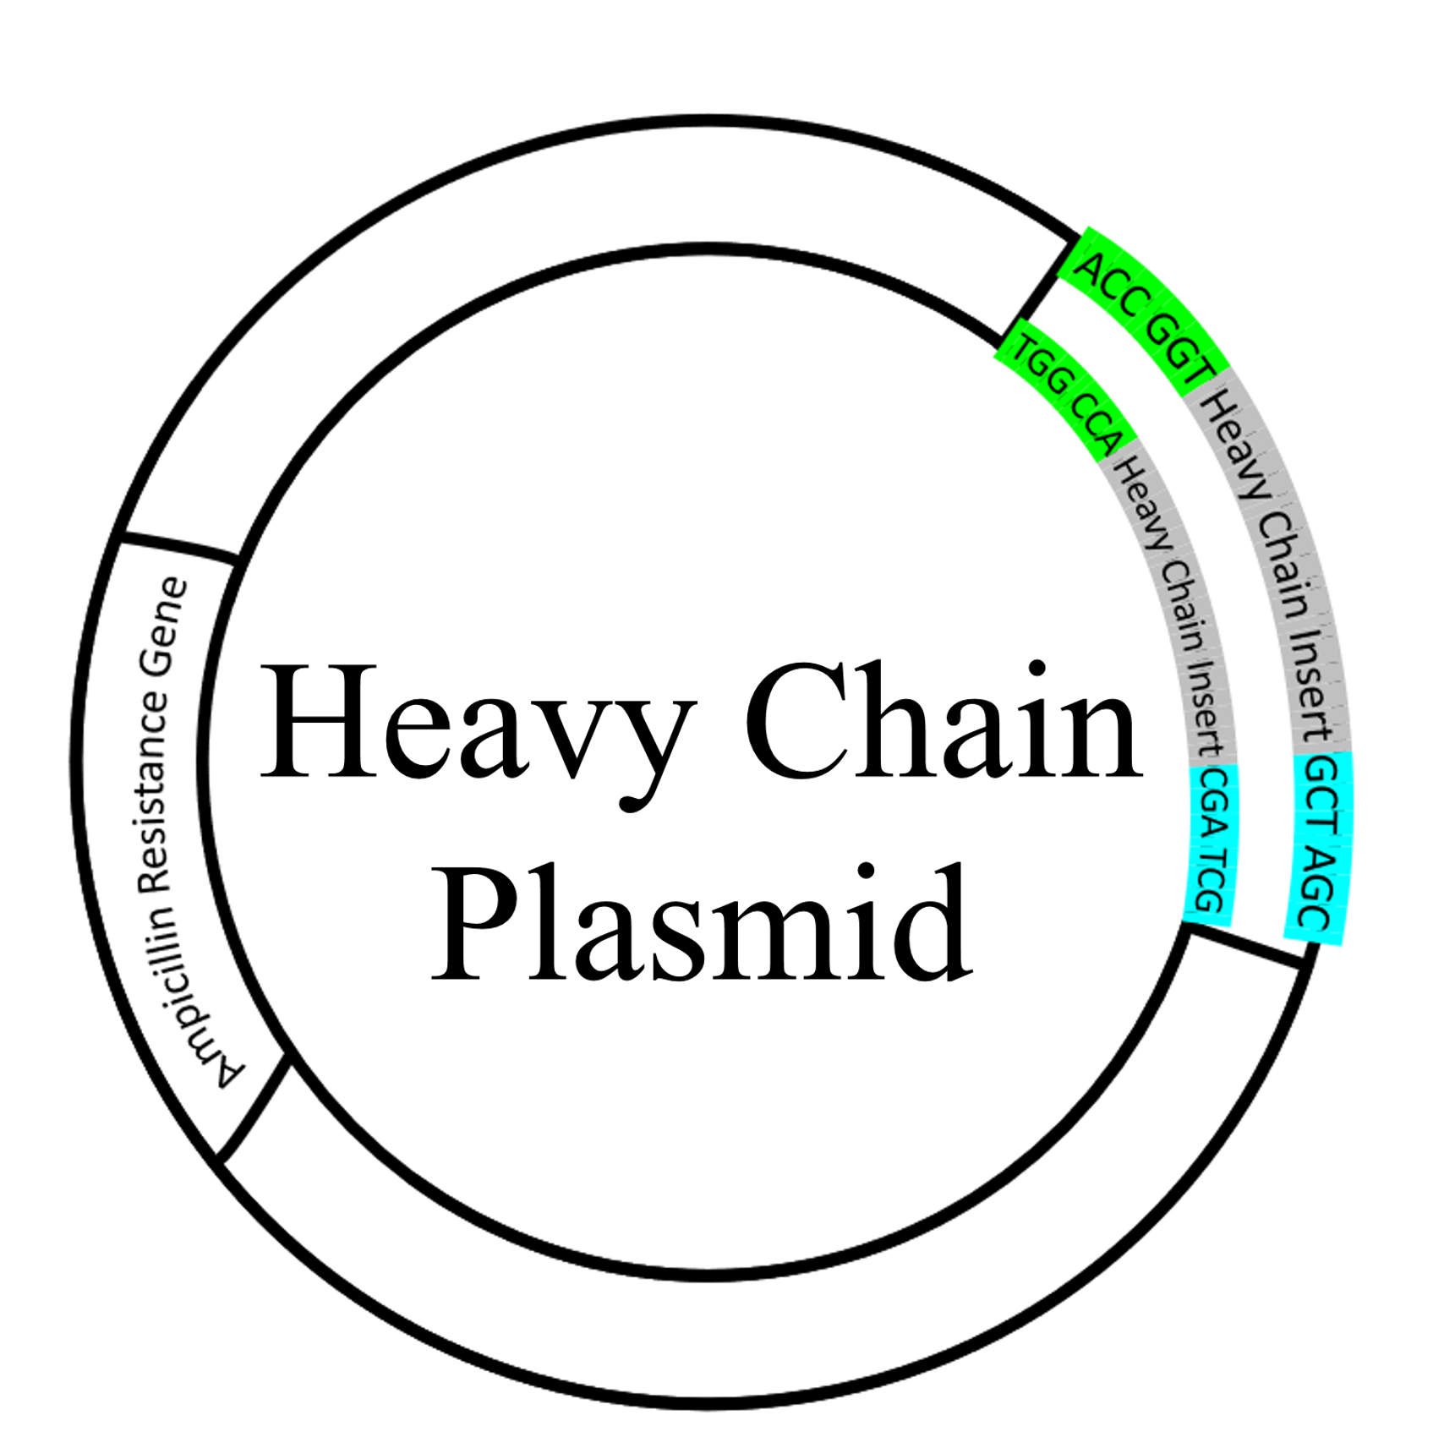
Amplification of Plasmid DNA

Slide 22
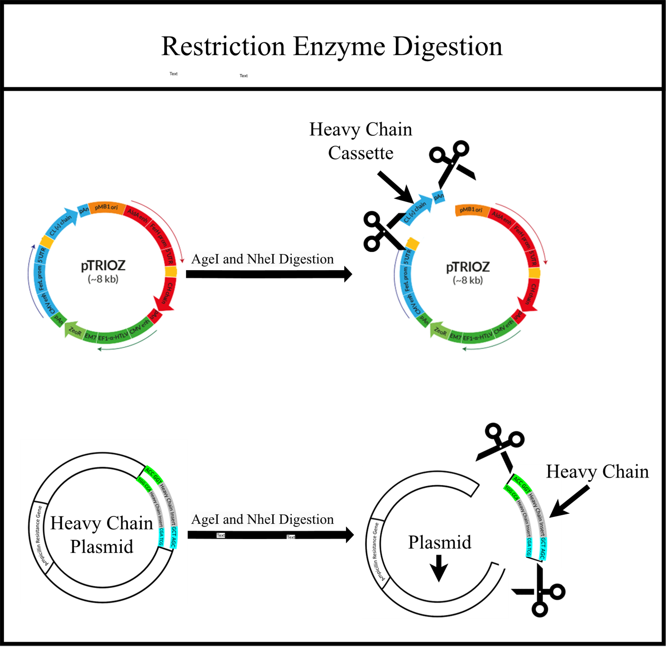
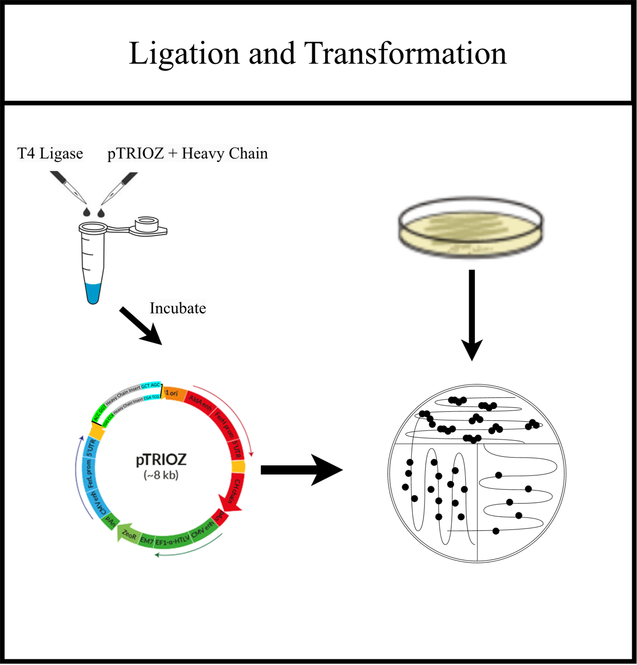
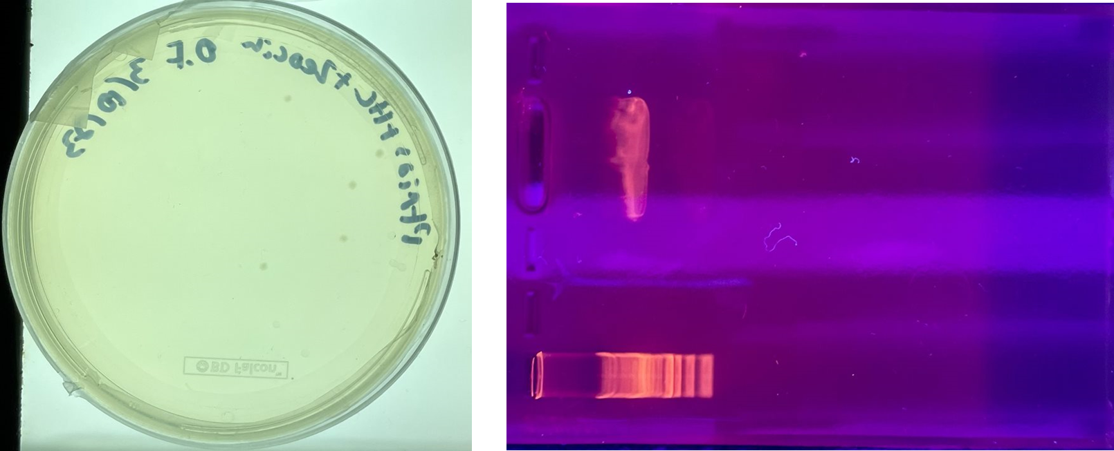
Heavy Chain Insertion Process

Slide 23
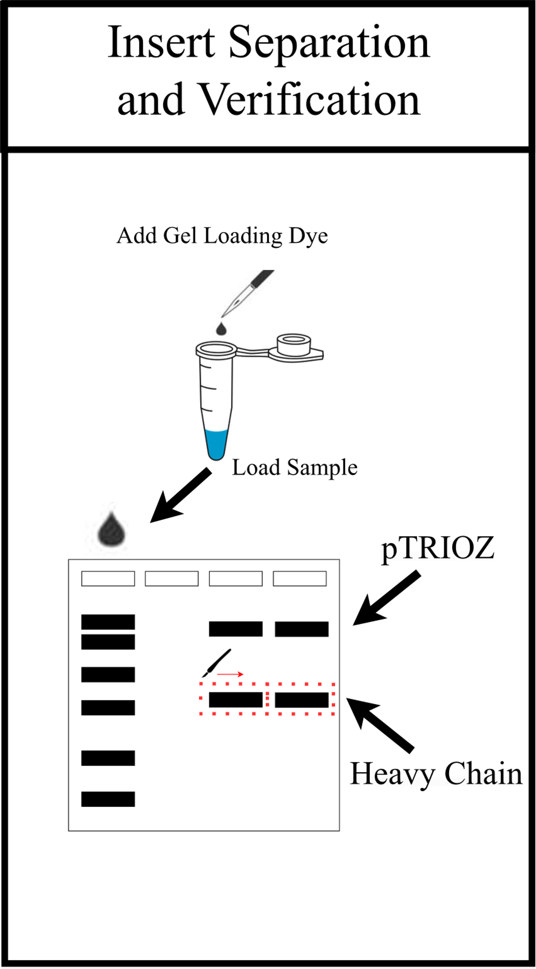
Heavy Chain Verification

Slide 24
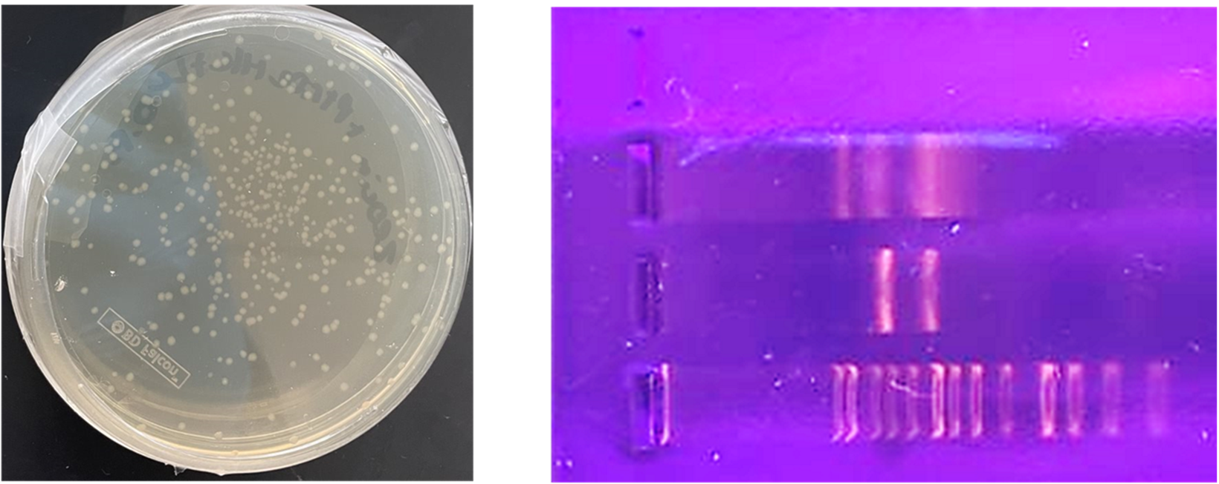
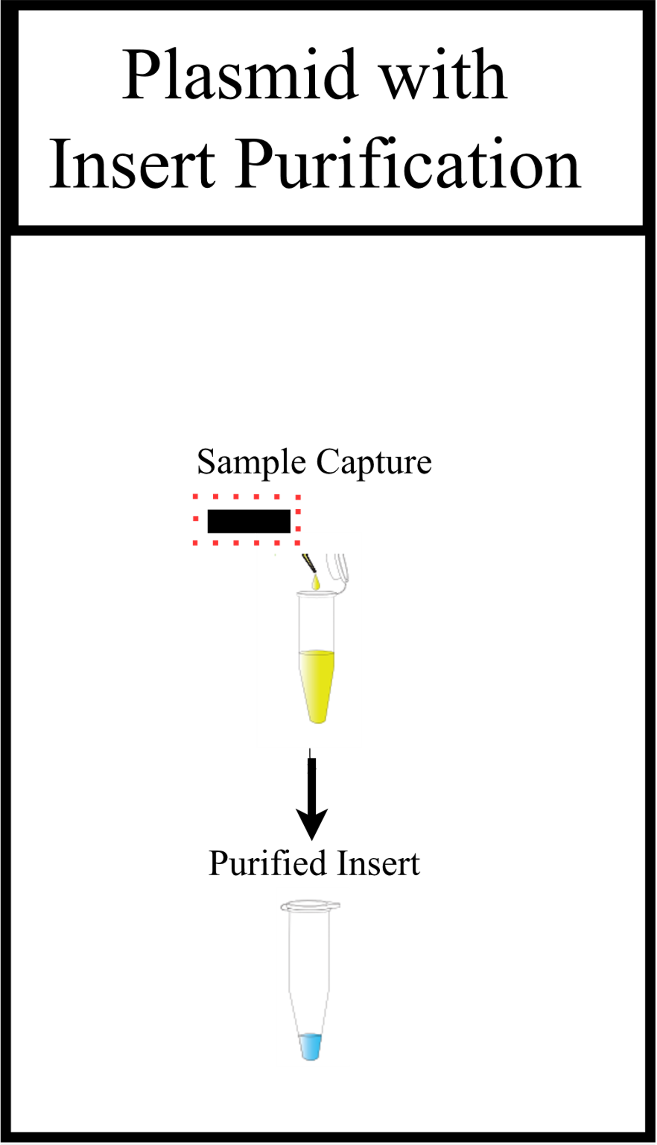


pTRIOZ Purification
Heavy chain successfully inserted.
Light chain digestion requires purification before ligation.

Slide 25

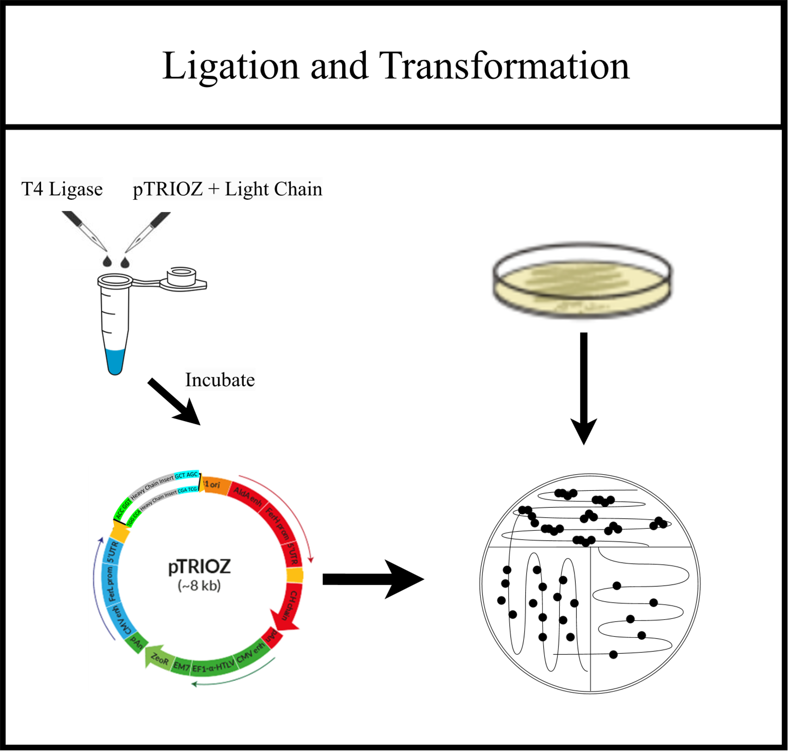
Light Chain Insertion Process

Slide 26
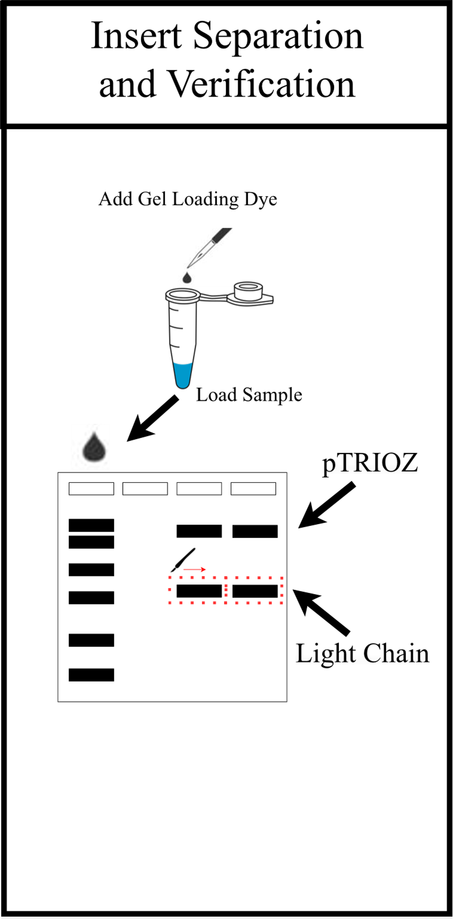
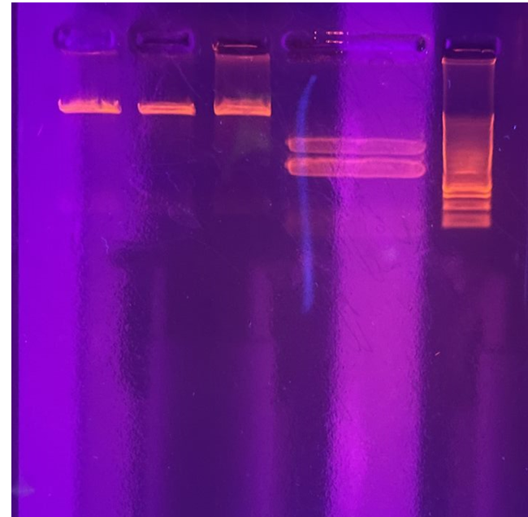
Insert Verification
Heavy Chain
Light Chain

Slide 27

Conclusions / Future Work
Produce monoclonal antibodies in mammalian cells and perform binding studies for interaction with human colon cancer cells (HCT 116).

Slide 28
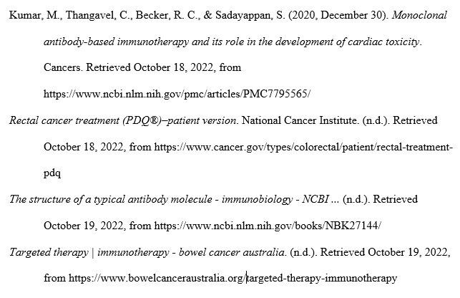
Sources:

