Slide 1

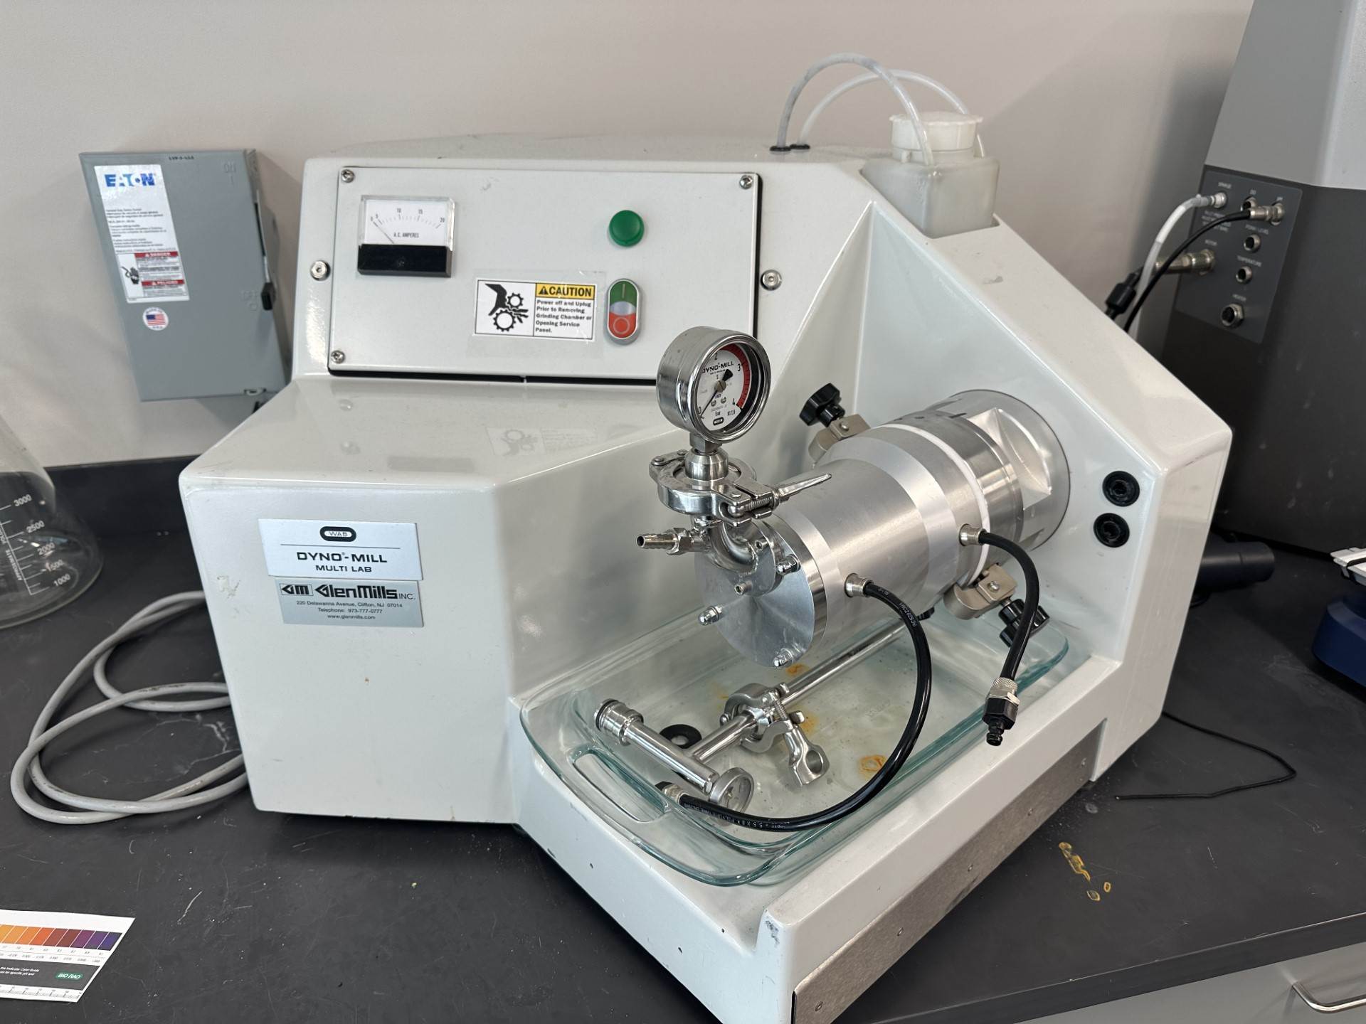
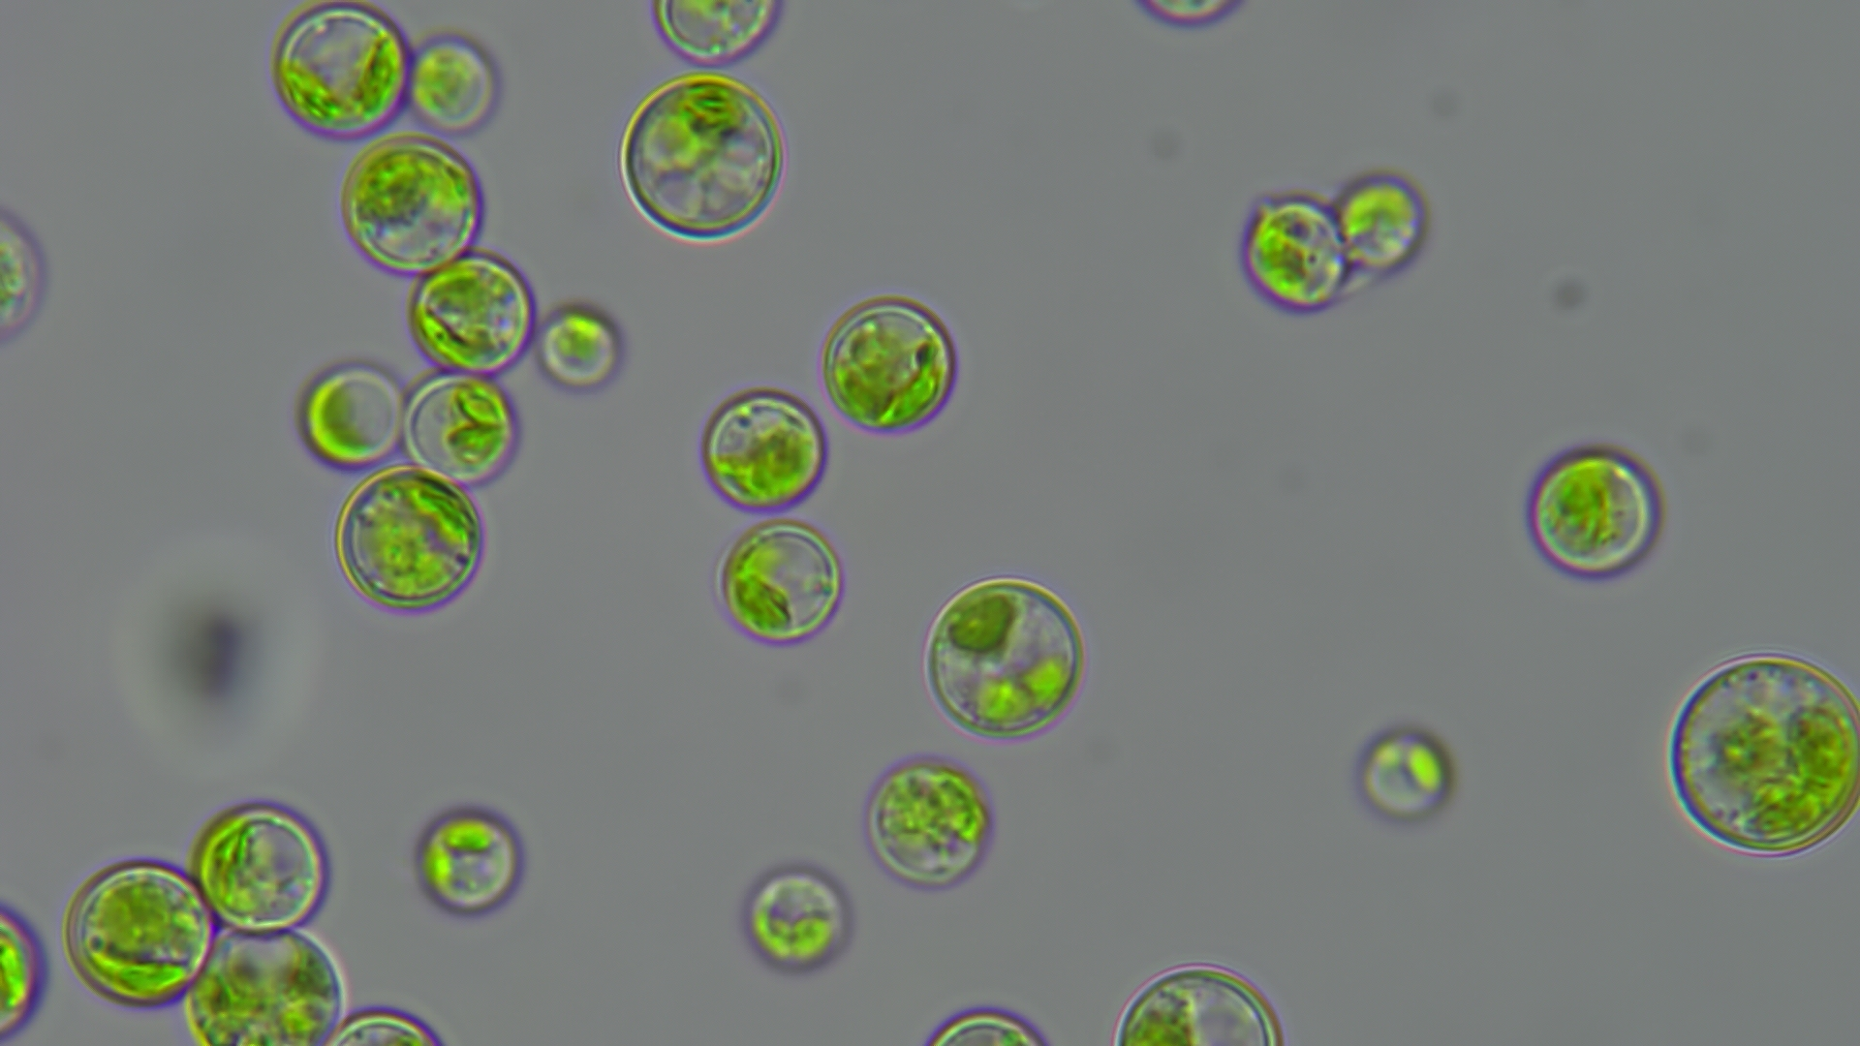
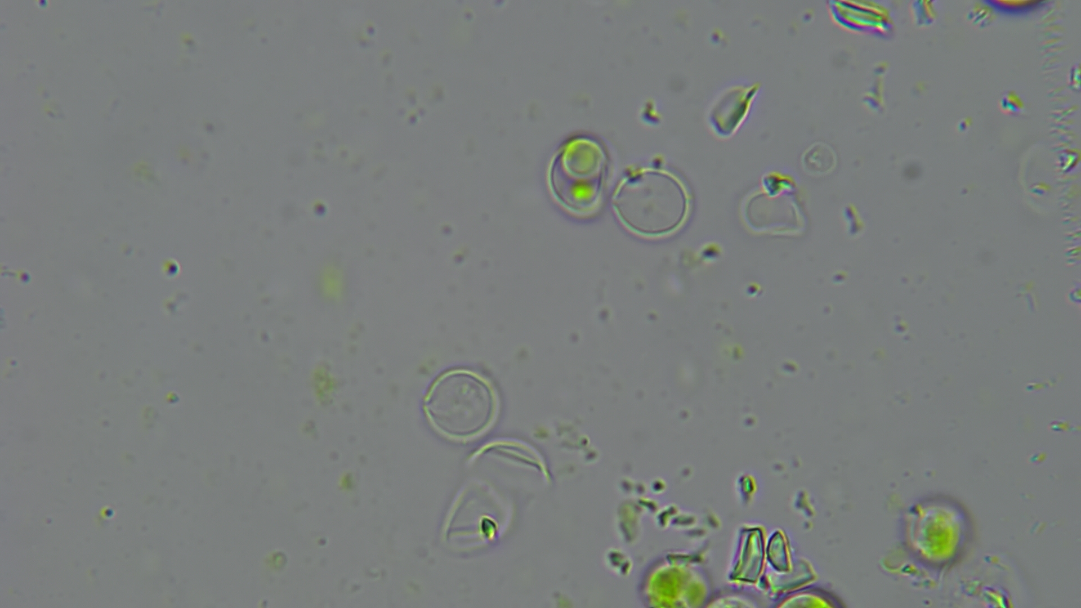
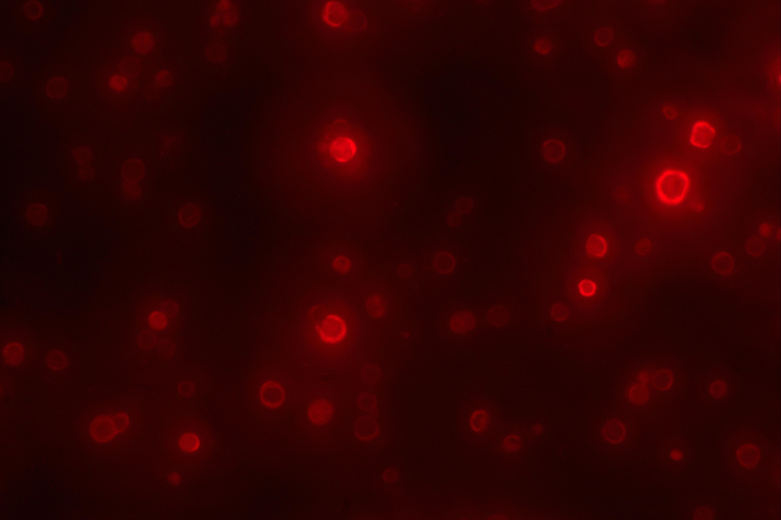
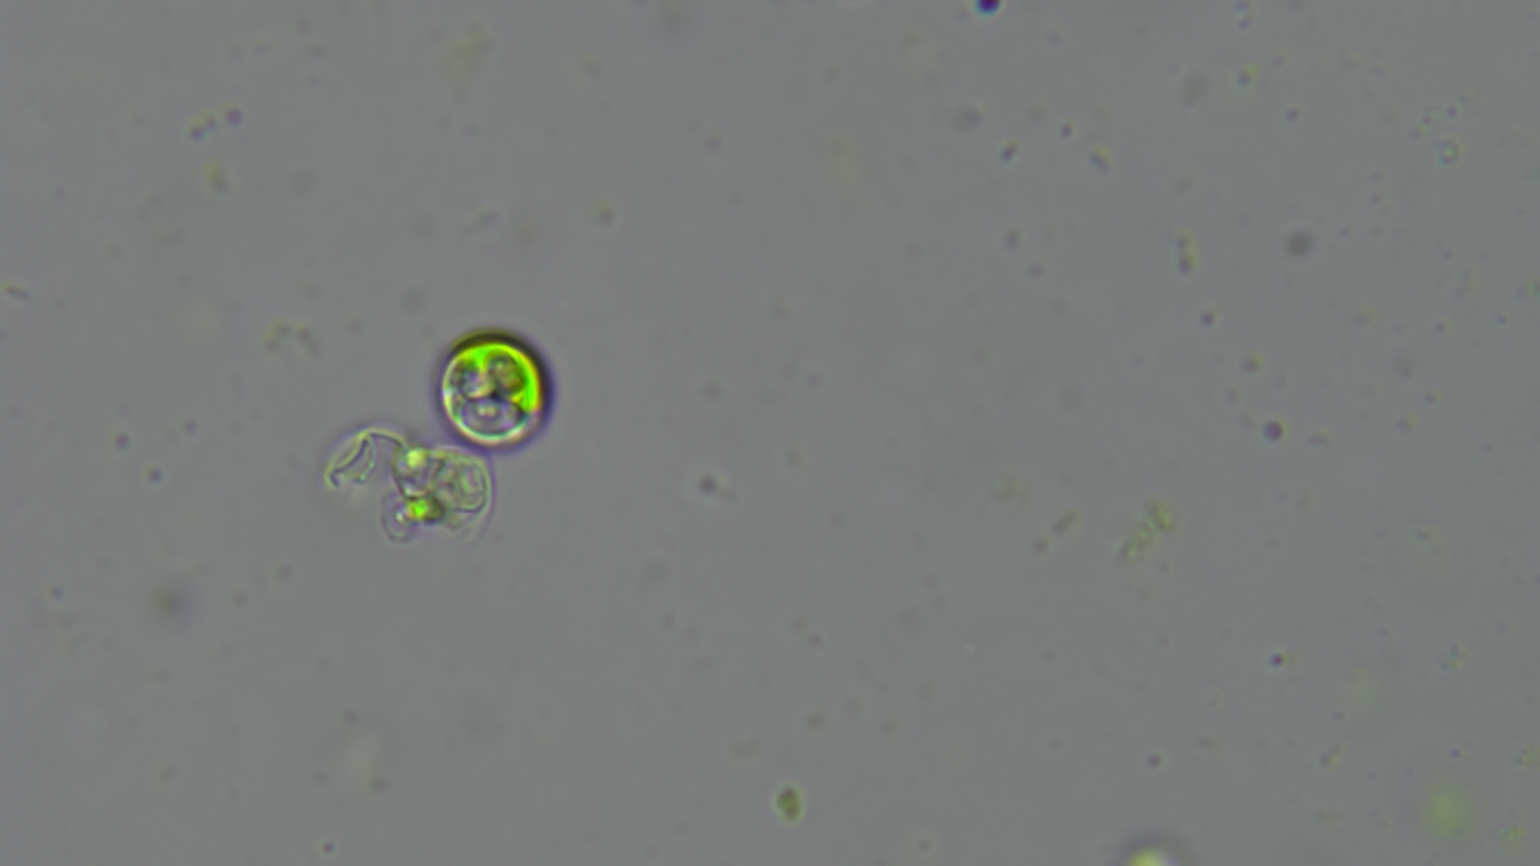
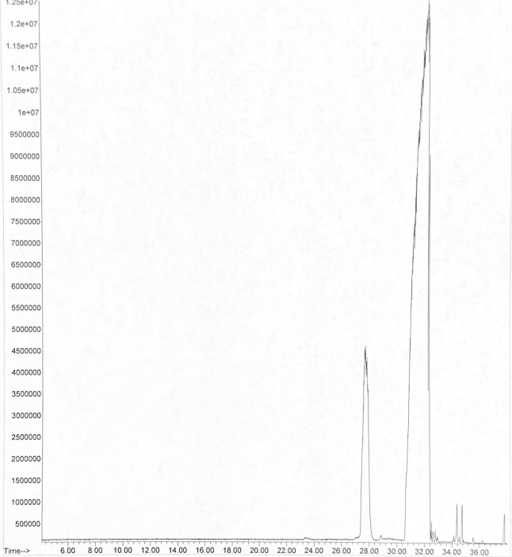
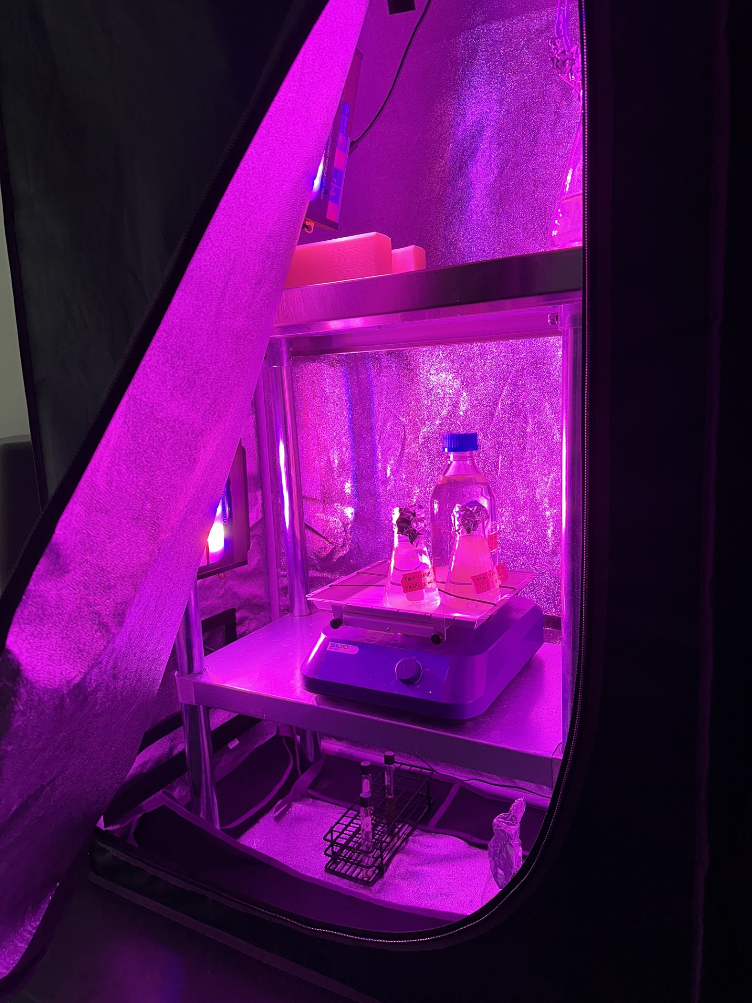
Green Gold: Harnessing Chlorella Prothothecoides for Sustainable Biodiesel Production
Landon Henderson, Dr. Borden, J.
Abstract
Algae-based biofuels, particularly those derived from Chlorella protothecoides with its high lipid content and rapid growth, offer a promising sustainable energy alternative to fossil fuels. This abstract highlights the unique characteristics and potential of Chlorella protothecoides for biofuel production, advocating for continued research and investment in algae-based biofuels for a greener future.
Objectives
Maximize lipid extraction from Chlorella protothecoides with an optimized solvent system.
Analyze lipid composition using GC-MS for detailed profiling.
Continuous bead mill
Brightfield image of non-lysed cells
Brightfield image of cell debris
Methods
Extraction
Centrifugation: Separate algae from medium via centrifugation
Resuspension: Resuspend the algae pellet in water to prepare for subsequent steps.
Mechanical Disruption: Use beads and vortex mixing for cell lysis.
Chemical Extraction: Treat with 125% w/w oil methanol and 0.5% w/w oil sodium methoxide in a 60°C water bath for 60 minutes to extract target compounds.
Purification: Wash the sample with equal volume of hexane to remove impurities.
Analytical Extraction: Pipette top layer for compound analysis.
Materials and Devices
Chlorella protothecoides
Agilent Technologies 5975C MS
Agilent Technologies 7890A GC
Beakers
Grow lights
Grow tent
Thermometer
pH probe
Plate reader
LB agar
Graduated cylinders
Centrifuge
Vortex
Microscope
Fluorescent image with nile red
Brightfield image of broken cell wall
Future Work
GC-MS Analysis
Refine GC-MS Method: Improve lipid analysis in Chlorella protothecoides by exploring new derivatization techniques, optimizing chromatography, and validating accuracy with internal standards or spiked samples.
Advanced Growth Strategies: Enhance Chlorella protothecoides growth for higher lipid content by adjusting nutrients, optimizing light, testing new culture media, and controlling pH and temperature.
Optimized Cell Lysis: Develop efficient cell lysis methods for Chlorella protothecoides, using mechanical disruption, enzymes, and specialized lysis buffers for better lipid extraction.
2
Analysis
Microscopy: Observing cells under microscope for wall rupture & lipid release.
GC-MS TEMPERATURE PROGRAM:
60°C ramping to 250°C at 5°C/min
Insert 1 uL into a 100:1 split injection
Using GC-MS program, analyze what left the column
1
3
Peak 1:Methyl Palmitate – 23% of peak area
Peak 2: 9,12 Octadecadienoic acid methyl ester – 71% of peak area
Peak 3: Methyl 11 Eicosenoate – 5% of peak area
Acknowledgements
Dr. Jacob R. Borden
Dr. Tony Lason
John J. McKetta Department of Chemical and Bioprocess Engineering
Grow tent with grow lights

