Slide 1
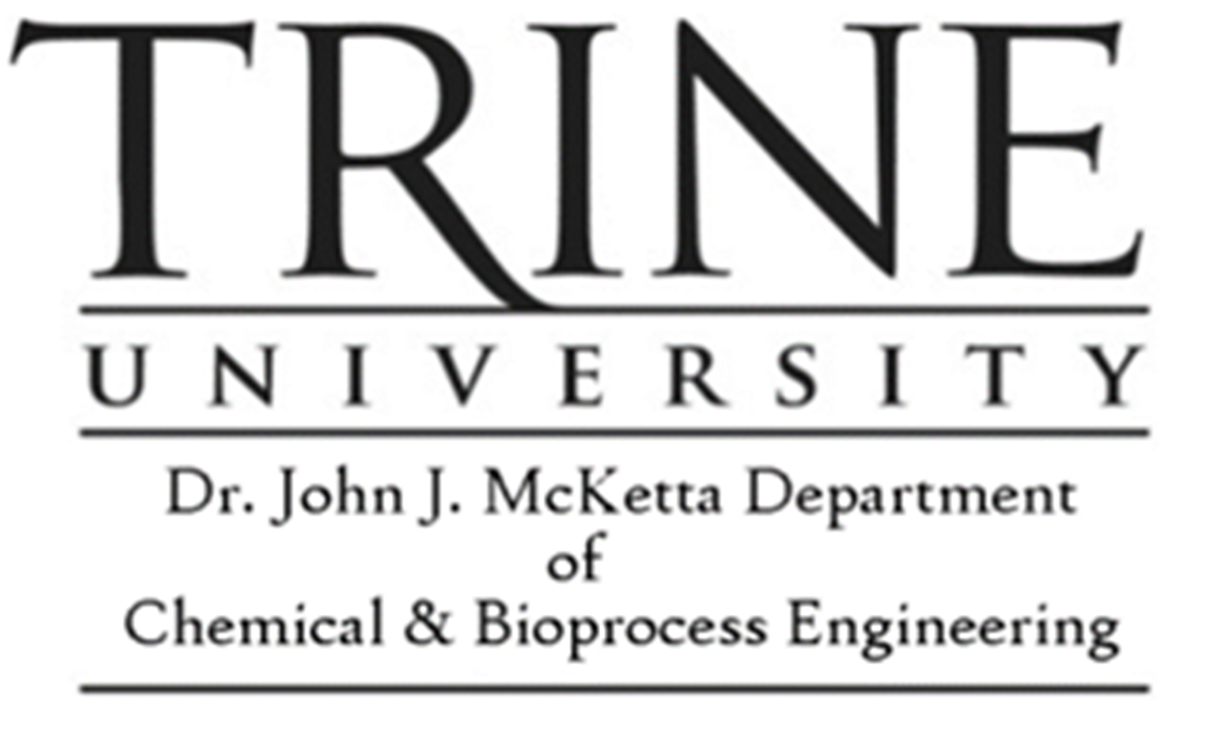

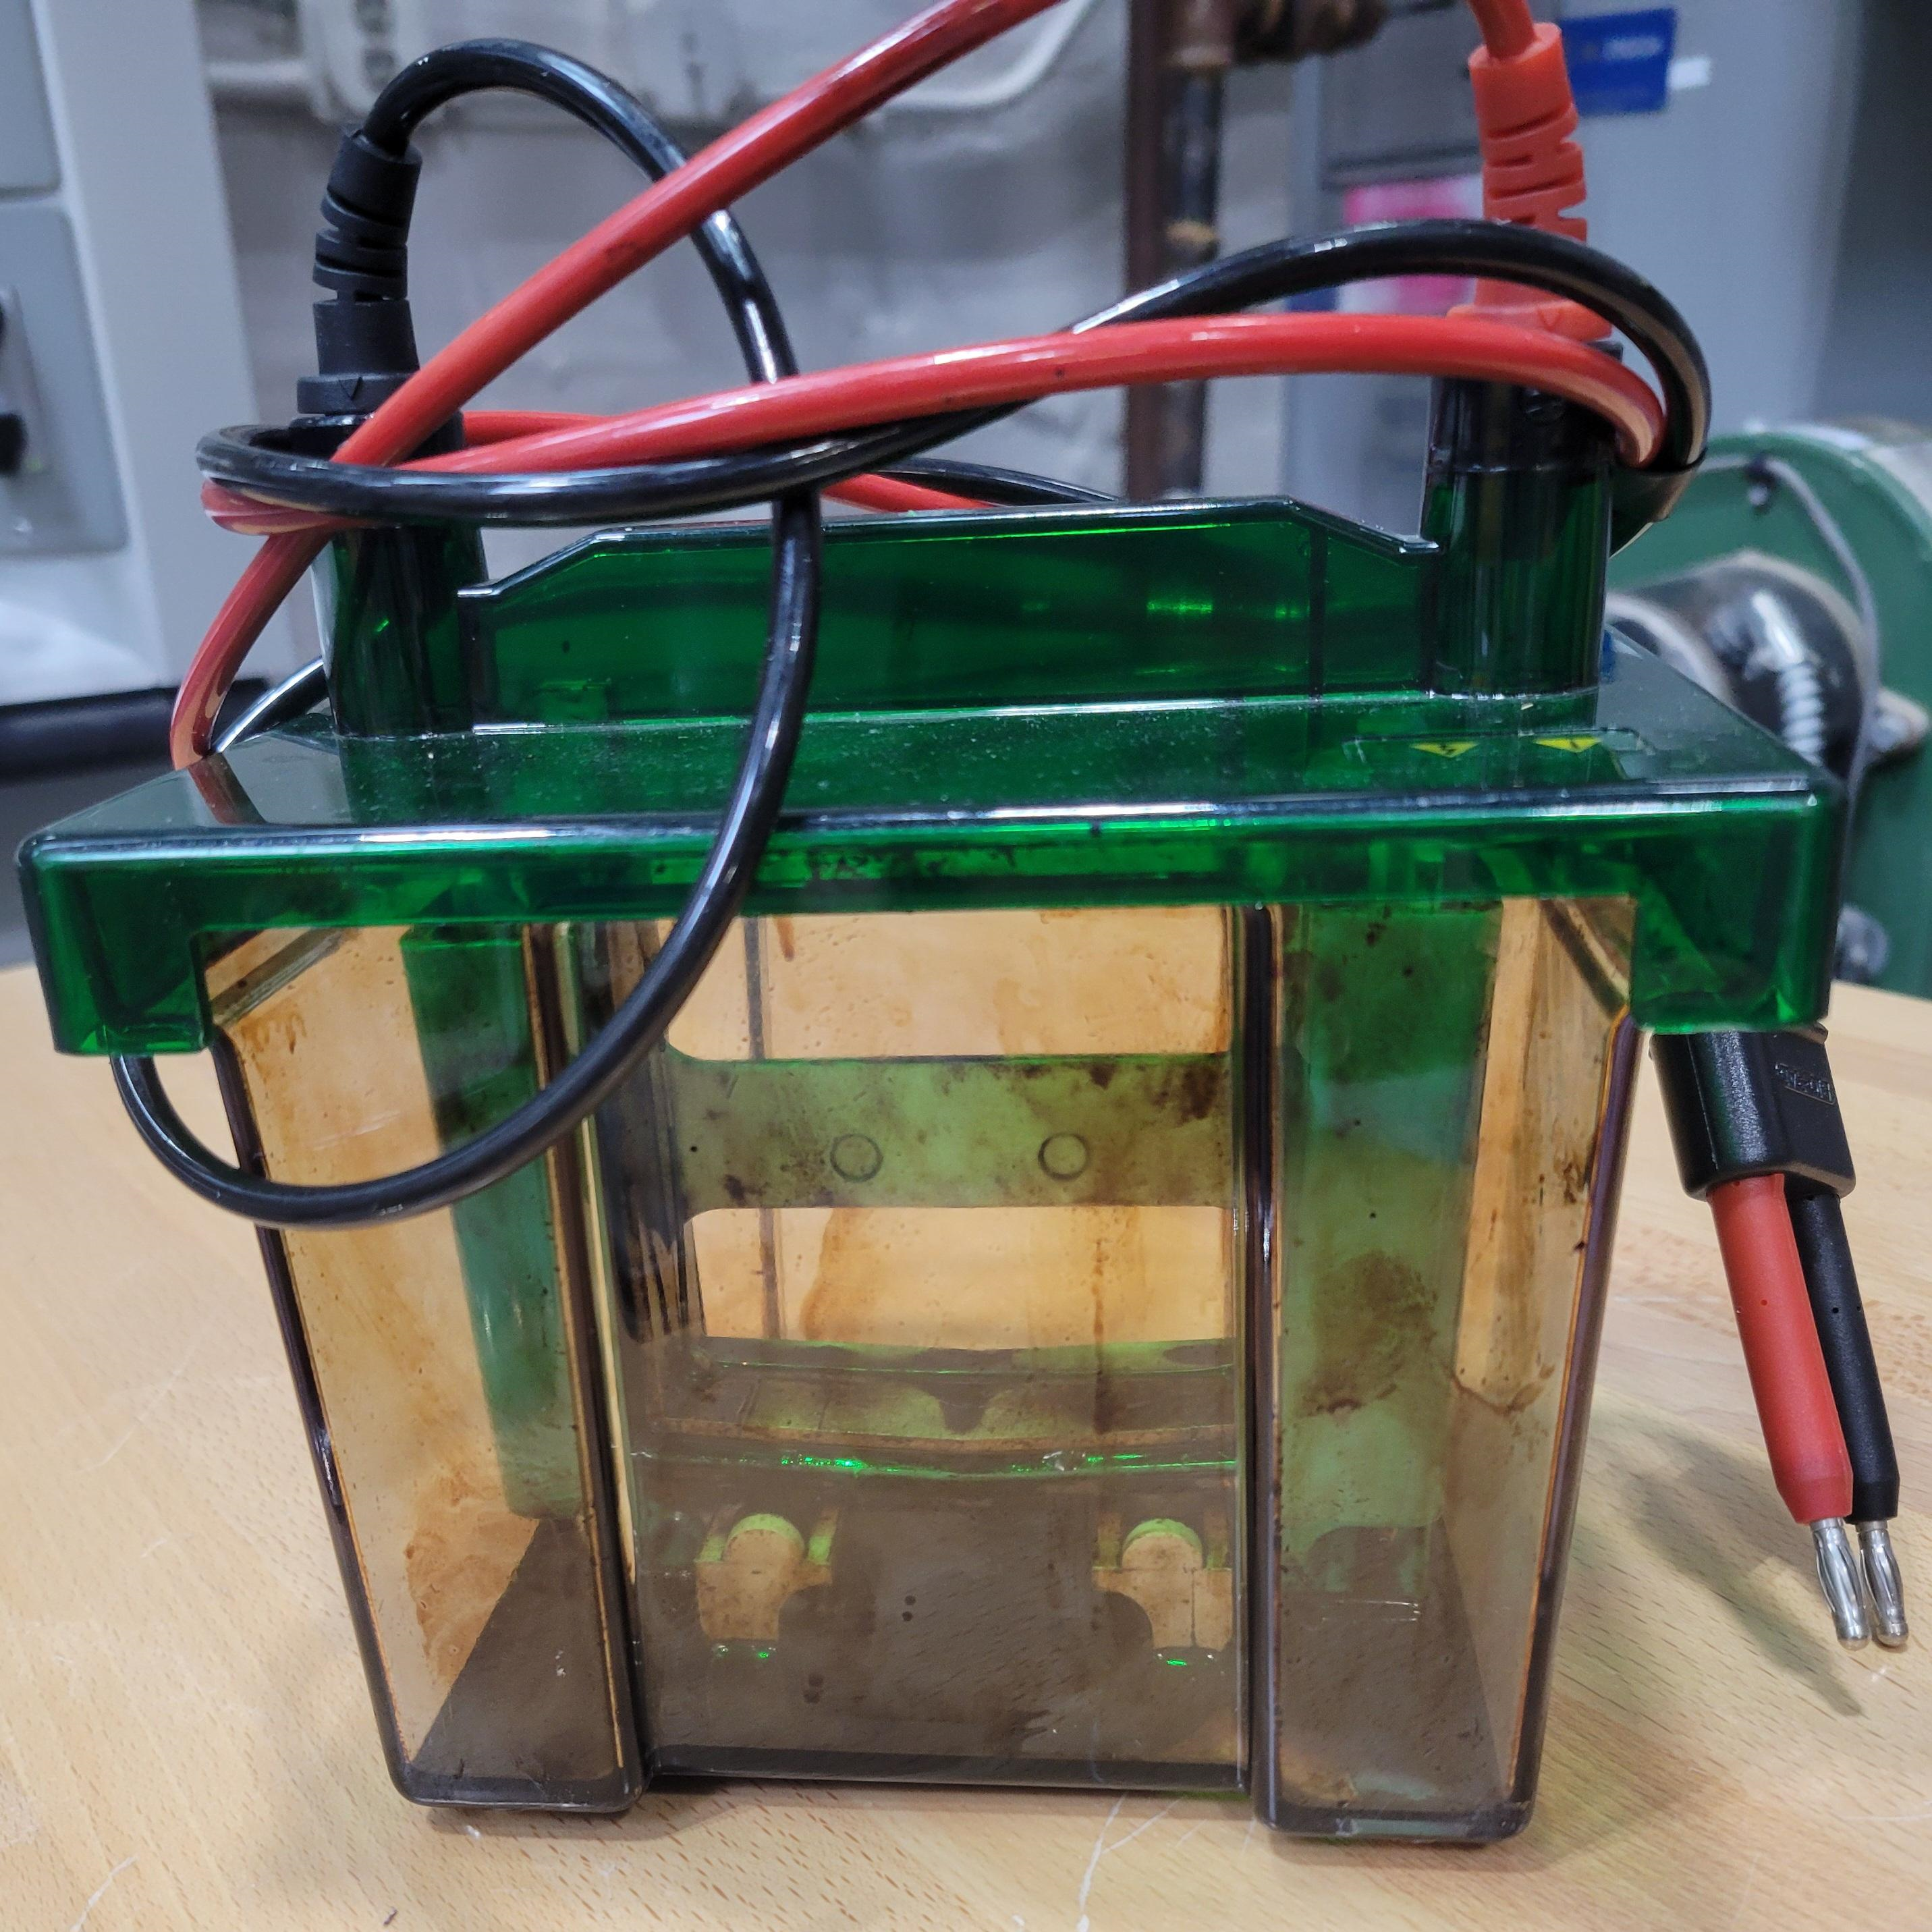
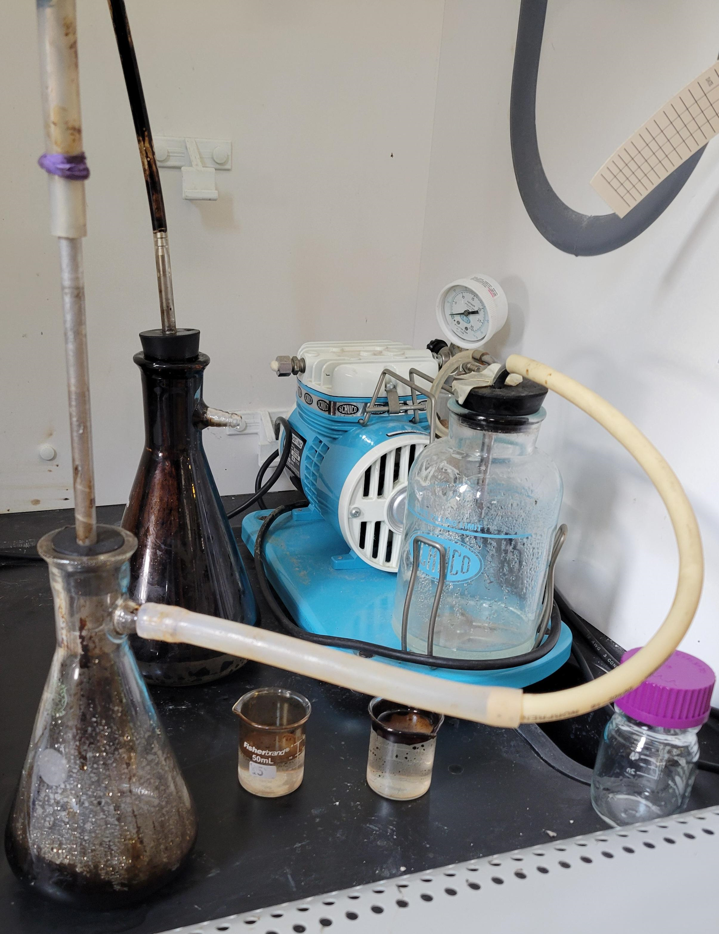
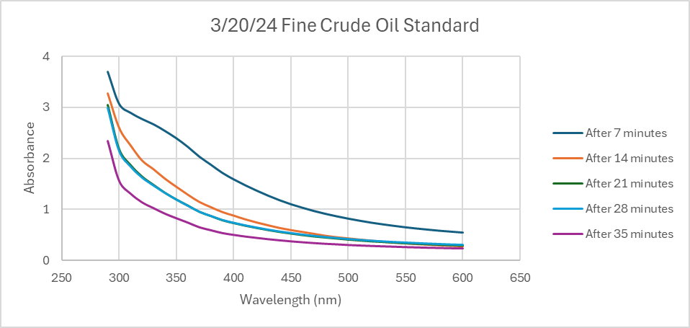
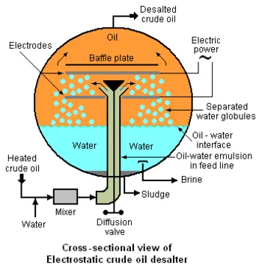
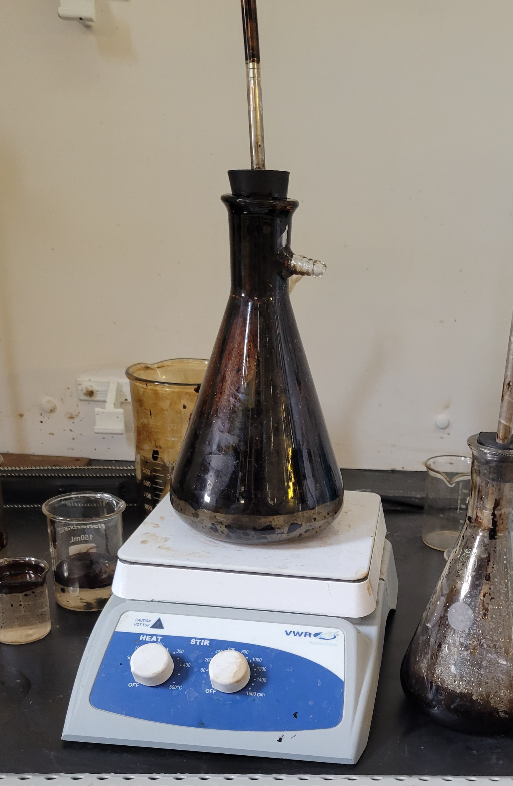
Optimization of Desalting of Crude Oil
Joshua L. Scott
Dr. John J. McKetta Department of Chemical & Bioprocess Engineering, Trine University,
ABSTRACT
RESEARCH OBJECTIVES
Electroporation
DATA & RESULTS
The escalating demand for oil as an energy source has led to the depletion of light crude oil reservoirs, prompting exploration of alternatives such as heavy crude oil. However, heavy crude oil's complex composition, including salts, poses challenges during processing, particularly in refining. To get the salt out water emulsifiers are used to mix the water with the crude oil. Effective separation methods to separate the water retaining the salt out of the oil include, demulsification using silicon-based compounds, electroporation, and heat.
Determine how heat, electroporation, and demulsifiers affect both separation between oil and water, and separation between oil and salt.
Determine a more effective way to separate the water and salt from the oil
To observe how electricity affects the separation of crude oil and saltwater an electrophoresis box will be used. The saltwater and crude oil will be mixed then poured into the electrophoresis box. A power box will be used to send a current into the electrophoresis box for separation.
Fine Oil Standard
To compare how heat electroporation, and Demulsifiers affect fine crude oil a standard had to be taken. The conductivity of each sample after being drawn was done by using a conductivity meter. The absorbance was done using a plate reader in which the wavelength from 300 nm to 600 nm was taken
MATERIALS & METHODS
Standard
Introduction
One significant concern is the presence of salts in crude oil, which must be separated before the refining process can commence. Failure to do so can result in detrimental effects during distillation, as the high temperatures exacerbate the corrosive nature of the salts, leading to damage to the equipment. Typically, the separation process involves washing out the salts with water, resulting in a mixture of salt, crude oil, and water. This is done in an industrial unit called a desalter.
Methods for effective separation:
  Utilization of demulsifiers, electroporation, and heating
Role of demulsifiers:
  Critical in separation process
  Leverage silicon-based compounds
  Attract water, repel oil
Importance:
  Facilitates separation of water and salt from crude oil
  Ensures smoother refining process
  Safeguards equipment integrity
Figure 3: Table to observe the amount of salt in water
Figure 6: Electrophoresis box for electroporation separation
Application of Heat
Figure 4: Graph to measure how much residual oil is left in water
CONCLUSIONS & FUTURE WORK
From the data collected for the fine crude oil standard a few things can be observed and could be fixed.
Use distilled saltwater mixture over just distilled water
Use more water to gather more samples
Avoid high concentration of oil for measuring conductivity
Use a different conductivity probe such as inductive conductivity probe
Figure 2: Setup for standard trial
Demulsifier
To observe how heat, demulsifiers, and electroporation affect the separation of water and salt from crude oil a standard must be taken.
Standardization procedure:
  Forceful mixing of water and crude oil for approximately 2 minutes
  Transfer of the mixture into an Erlenmeyer flask
  Sampling from the bottom of the flask using a vacuum pump
Measurement methods:
  Conductivity: Assess salt content using a conductivity meter
  Residual oil: Use a plate reader to measure absorbance
The use of Dowsil DM5 silicon based demulsifier from Dow will also be tested so see the separation affects. Testing that will be done:
Test demulsifier amounts in oil saltwater mixture standards.
Heat and test demulsifier amounts in oil saltwater mixture.
Apply electroporation with demulsifier in oil saltwater mixture.
Figure 6: Industrial desalter process
Future work involves testing different silicon and non-silicon demulsifiers to assess their impact on separation compared to the Dowsil DM5 demulsifier.
Figure 5: Use of hot plate to heat mixture
Acknowledgments
The application of heat applied to the fine crude oil will be performed to see how heat affects the separation process. To do this the oil and saltwater will be mixed as before, but then placed on a hot plate to heat up. To measure the temperature a thermal couple will be used to measure the temperature.
Dr. Jacob R. Borden
Marathon Petroleum
Dow Chemical
Texas Raw Crude
McKetta Department of Chemical and Bioprocess Engineering

