Slide 1

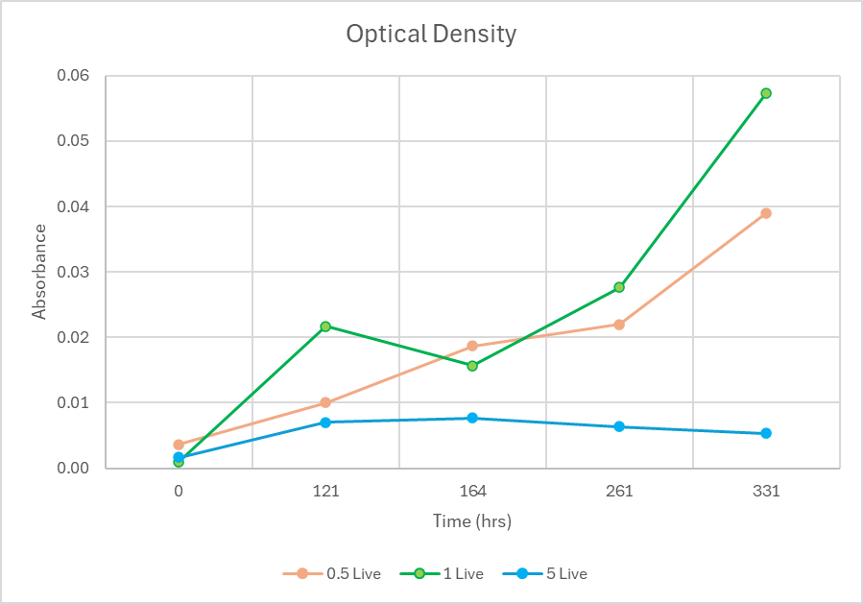
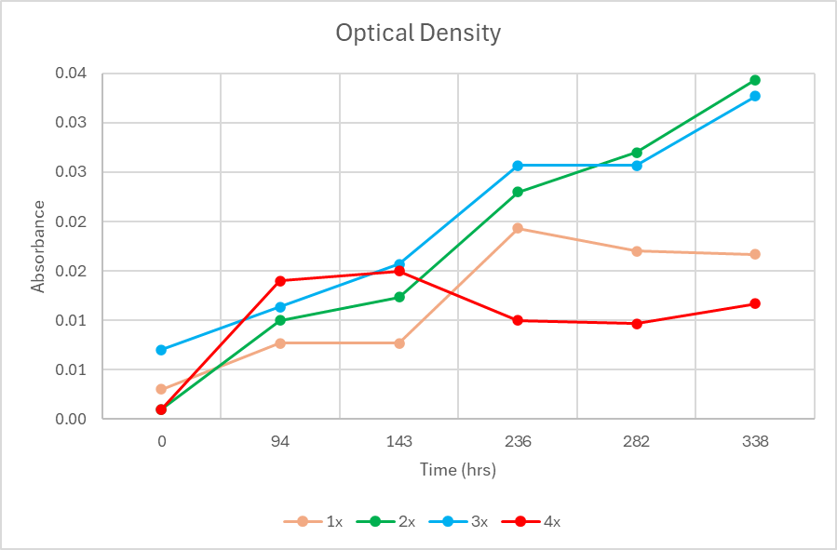
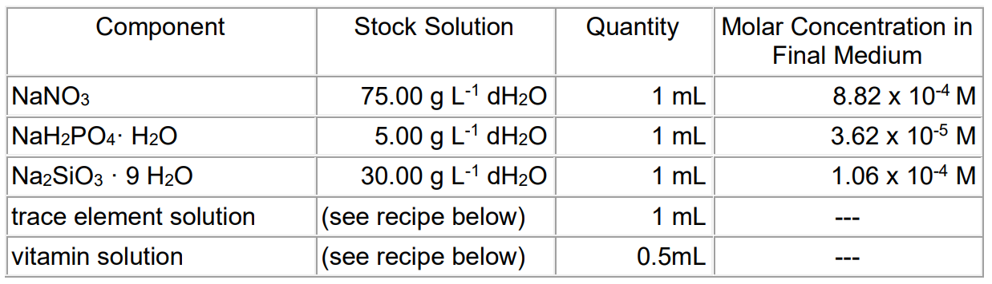
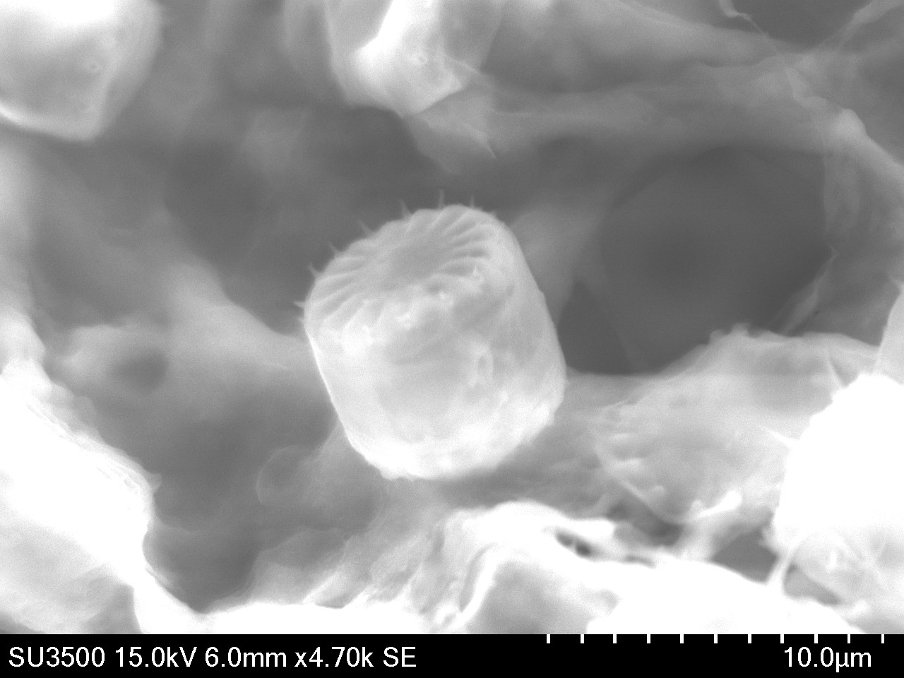
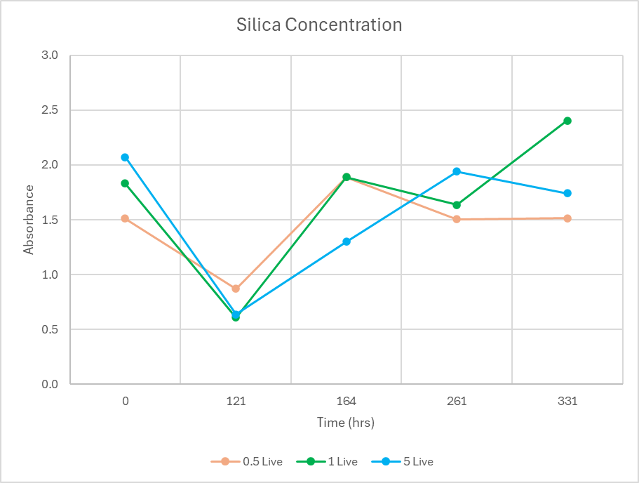
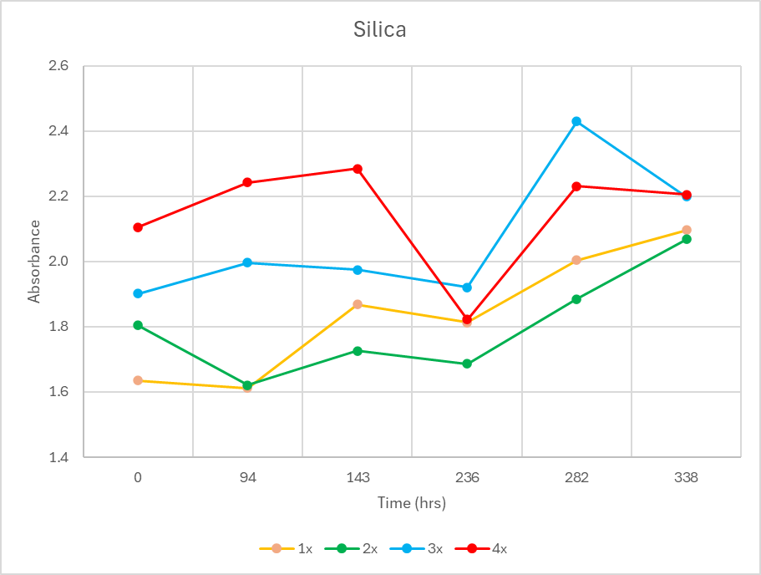
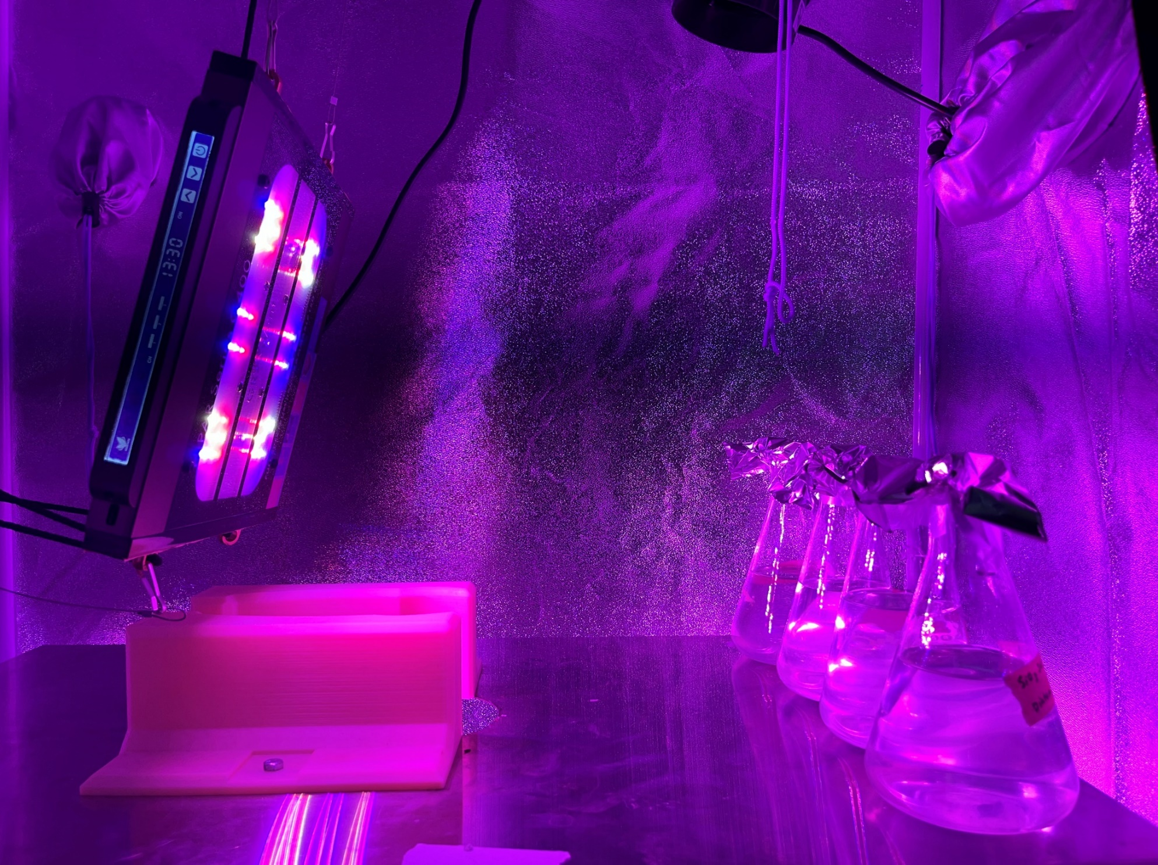
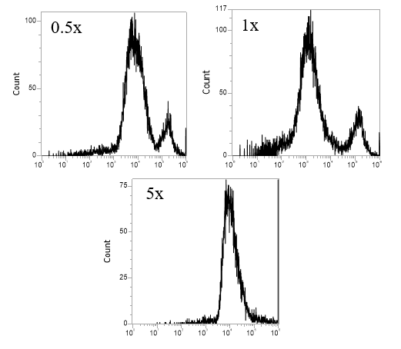
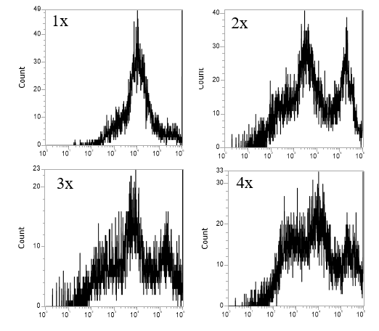
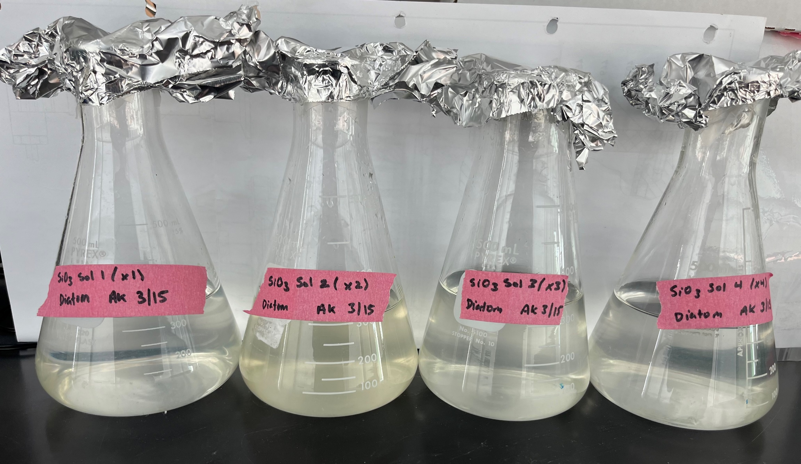
ABSTRACT
MATERIALS AND METHODS
DATA & RESULTS
Diatoms, distinguished by their silica shells, offer unique potential for biofuel production compared to green algae. This research aims to use diatoms, specifically Cyclotella cryptica (C. cryptica), for biodiesel synthesis by catalyzing the triacylglycerol (TAG) within them. C. cryptica was selected as the subject of study since it is rich in lipids (40% of biomass, 55% TAG). The research focused on determining the optimal silica concentration for maximizing C. cryptica growth and its subsequent impact on lipid content throughout the growth phase. Experiments were conducted by varying silica concentrations (0.5x- 5x). Results revealed that a 2x concentration of silica improved C. cryptica growth within a 14-day period.
The concentration of silica in the media base was the independent variable.
Figure 2: L1 marine media component list and concentrations (based on 1 L total volume
Silica 1x concentration: 1 mL Na₂SiO₃ / 1 L DI water
Trial 1: Silica concentrations of 0.5 x, 1x, 5x.
Trial 2: Silica concentrations of 1x, 2x, 3x, 4x.
Overall growth determined using OD using SpectraMax iD3 microplate reader at 436 nm.
Silica concentration determined using Hach Reagent set for Heteropoly Blue method and OD using SpectraMax iD3 microplate reader at 815 nm.
Lipid concentration throughout the trials was determined using a flow cytometer and Nile Red staining. Excitation was 488 nm and emission was at 695 nm.
Figure 5: Trial 1 results of cultivating of C. cryptica in varying concentrations of silica.
Figure 6: Trial 2 results of cultivating of C. cryptica in varying concentrations of silica
Figure 7: Trial 1results of silica content at intermittent times.
Figure 8: Trial 1results of silica content at intermittent times.
Figure 1: SEM image of C. cryptica.
Figure 3: Experimental set-up of varying silica concentration in Trial 2.
PREVIOUS WORK
Guillard and Hargraves (1993) created L1 marine media for growing coastal algae. This media was used in this experiment to grow C. cryptica. Fake seawater base was composed of 28 g*L⁻¹ NaCl in deionized water.
Media Base Variation: Real seawater pulled from the Boston Harbor was tested to see impacts on C. cryptica growth compared to lab created seawater. Real seawater had more effective growth by a factor of 7.6.
Growth Additive Optimization: Growth additives listed in Figure 2 were varied by a factor of 1x, 1.5x, and 2x in a design of experiments with 65 total trials. The only growth additive with a statistical impact on C. cryptica growth was silica.
Figure 9: Trial 1results of lipid content at a time of 331 hours.
Figure 10: Trial 1 results of lipid content at a time of 336 hours.
CONCLUSIONS & RECOMMENDATIONS
ACKNOWLEDGEMENTS & REFERENCES
C1: 2x concentration of silica showed most effective growth.
C2: Limited impact of silica on improved growth.
R1: Improve method to find silica concentration.
R2: Determine lipid concentration using microplate reader
instead of flow cytometry.
R3: Water quality studies on seawater to determine what other
factors impact diatom and lipid growth.
Dr. Samuel Drerup for starting sample of C. cryptica.
Funding by the McKetta Department of Chemical and Bioprocess Engineering
Guillard, R.R.L. and Hargraves, P.E. 1993. Stichochrysis immobilis is a diatom, not a chrysophyte. Phycologia 32: 234-236.
Mark Hildebrand et. al. The place of diatoms in the biofuels industry. Biofuels (2012) 3(2), 221–240
d ’ Ippolito et al. Potential of lipid metabolism in marine diatoms for biofuel production. Biotechnology for Biofuels (2015)
RESEARCH OBJECTIVE
Determine optimal silica concentrations to maximize overall diatom growth and lipid content.
Figure 4: Flasks at the end of Trial 2. 1x, 2x, 3x, and 4x shown left to right.

