Slide 1
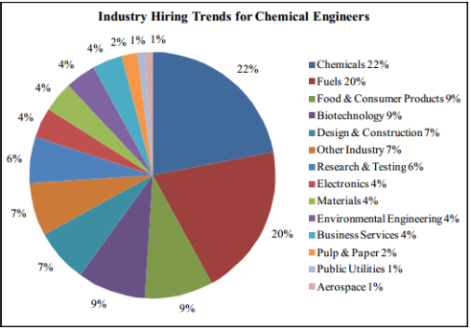
Industries
Chemicals
Oil & Gas
Energy Conversion / Use
Pulp and Paper
Rubber and Plastics
Food and Beverage
Textiles
Electronics / microelectronics
Metals and Minerals processing
Agricultural Chemicals
Cosmetics
Pharmaceuticals
Biotech / Biomed
Environmental
Legal / Intellectual Property
Higher Academia / Professors

Slide 2
Job Descriptions
Process Engineer
Operations Engineer
Environmental Engineer
Compliance Engineer
Quality Engineer
Quality Assurance Engineer
Safety Engineer
Reliability Engineer
Project Engineer
Refinery Engineer
Sustainability Engineer
Maintenance Engineer
System Engineer
Design Engineer
Process Control Engineer
Production Engineer
Technical Service Engineer
Chemical Engineer

Slide 3
Resumes – Do’s and Don’ts
Do:
  Use proper grammar
  Use consistent fonts and spacing
  Pick one:
    Use full sentences w/ periods
    Use bullet points and no periods
  Use standard heading sections
    Education, Experience, Skills,
  Use action terms
    Created, modified, designed, etc./
    Don’t “claim” a skill, display it in words
Do:
  Include non-curricular skills and activities
    Sports, Glee club, band, band member, Volunteer work, etc
  Use keywords appropriate to the industry to which you are applying
  Ask others to see your resume and ask to see theirs
  Clean up your social media profiles

Slide 4
Resumes – Do’s and Don’ts
Do Not
  Use a silly email address
  Misspell anything
  Go over one page (yet)
  Include a generic “Objective” statement
  Leave large areas of white space
  Include references on the resume

Slide 5
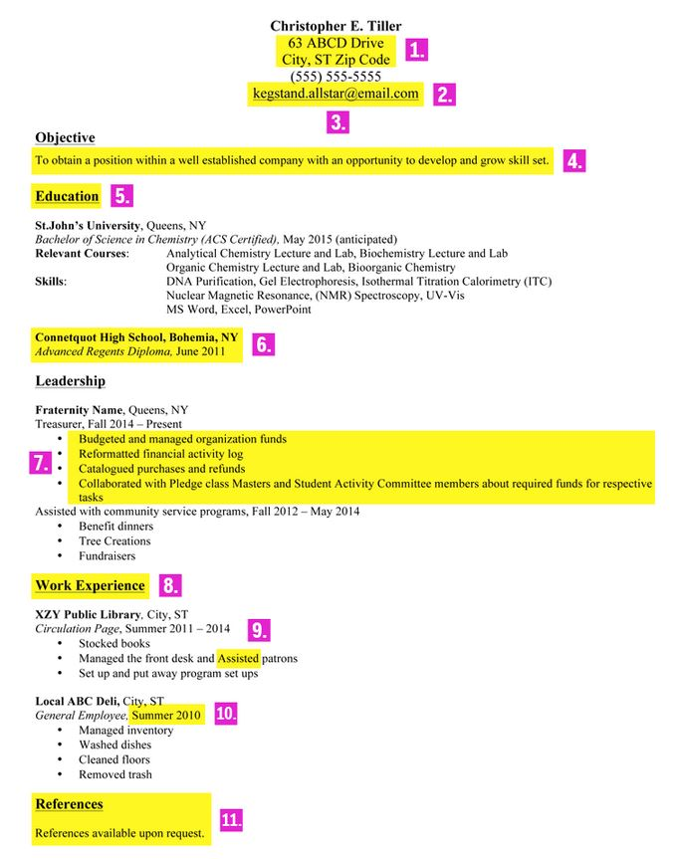

Slide 6
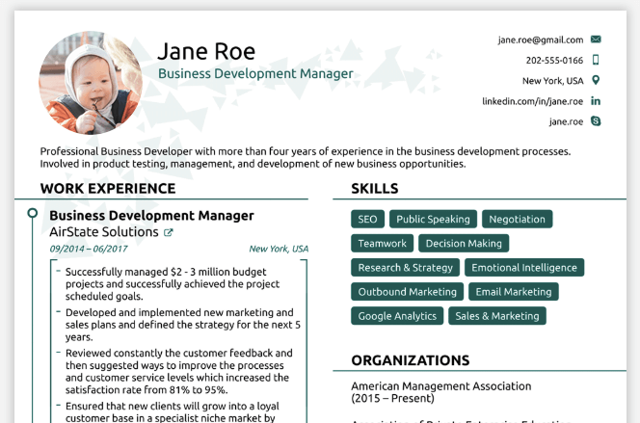

Slide 7
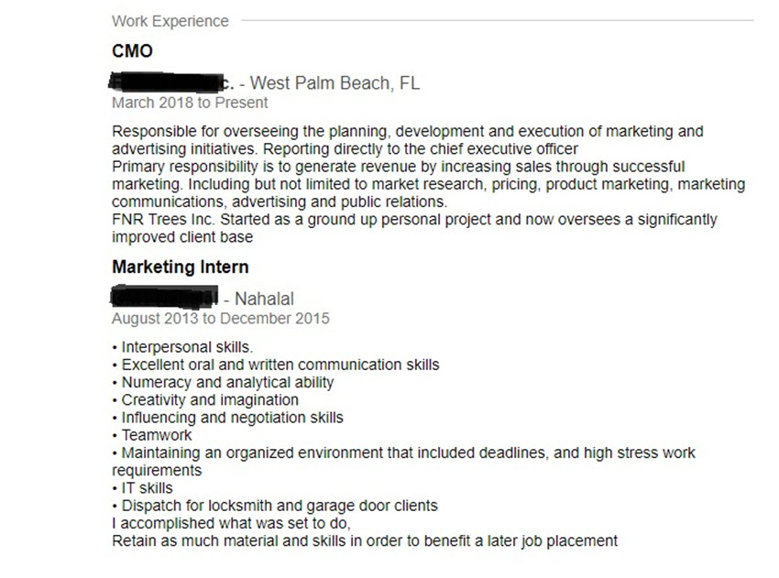

Slide 8
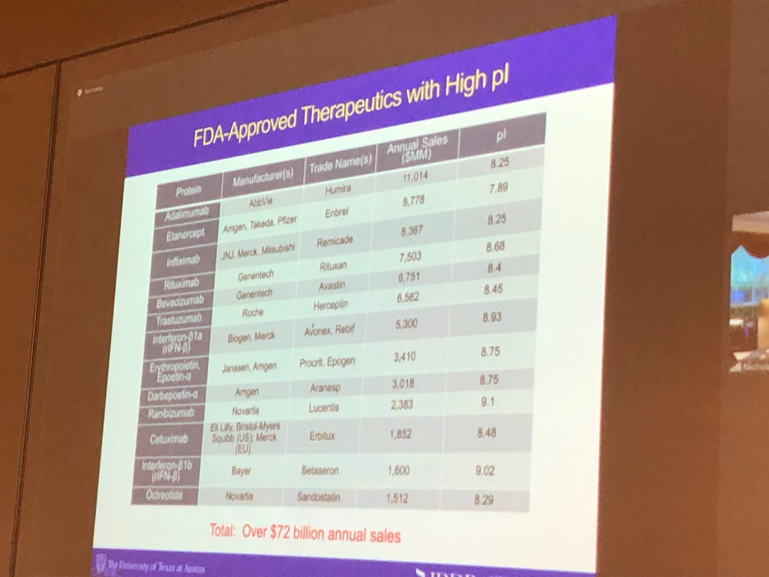

Slide 9
Engineerjobs.com
Aiche.org
Biotech-careers.org
Engineering.com
https://jobs.thechemicalengineer.com/
https://collegegrad.com/careers/chemical-engineers
Indeed.com
Glassdoor.com

